Slide 1
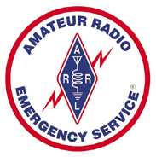
Basic Communication Skills for Emergency Operations
Clint Miller KØGR, COML
Story County ARES
October 1st, 2020

Slide 2
Introduction
Communications skills used during emergency operations are different than normal Amateur Radio operations
Quick, accurate, minimal complications
In an emergency, any given message can have huge and often unintended consequences
An unclear message, or one that is modified, delayed, miss-delivered or never delivered at all can have disastrous results

Slide 3
Introduction
A number of factors can affect your ability to do this:
Your own operating skills
Communication method used
Variety of noise problems
Skills of the receiving party
Cooperation of others
Adequate resources

Slide 4
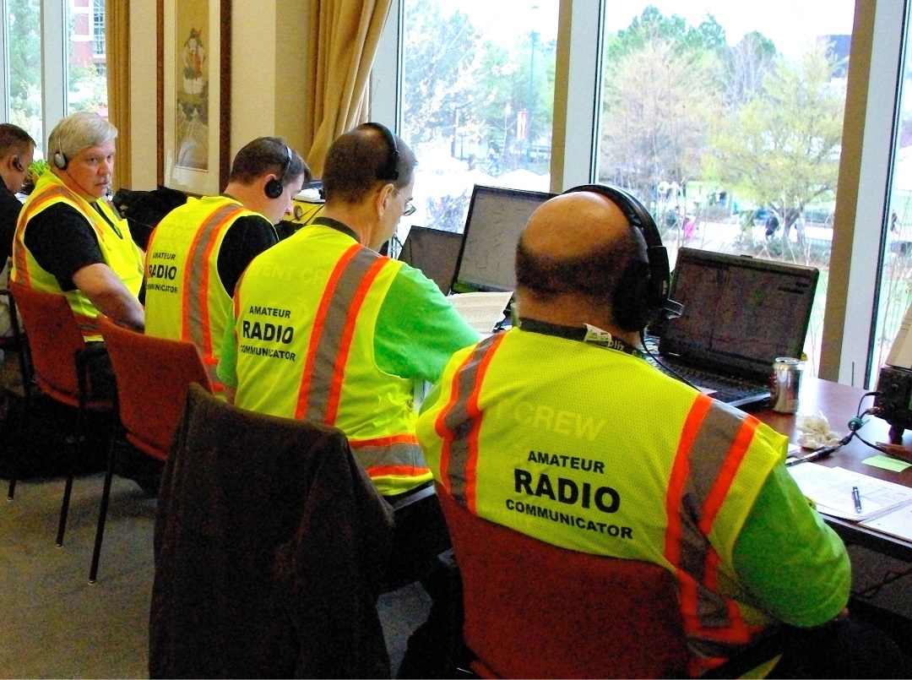
Listening
Listening is at least 50% of communication
Listening also means avoiding unnecessary transmissions
Local ambient noise and/or weak radio signal conditions may make it difficult to perform your emergency communication responsibilities
Head phones help under
these conditions

Slide 5
Microphone Techniques
For optimum performance
Hold the mic close to your cheek
Just off to the side of your mouth
Talk across, rather than into, the microphone
Speak a little slower and pause longer between transmissions
Voice operated transmissions (VOX) are not recommended for emergency communications

Slide 6
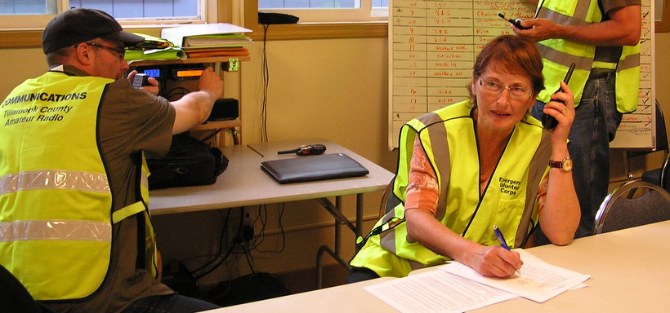
Brevity & Clarity
Each communication should consist of only the information necessary to get the message across clearly and accurately
If you are the author of a message, change the wording as necessary to make it as clear and short as practical
If you are not the author, work with the author to achieve same

Slide 7
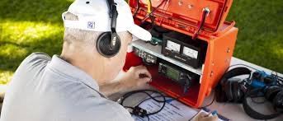
Brevity & Clarity
If you can not locate the author, pass the message as stated with any errors or redundancies included.
DO NOT CHANGE MESSAGES!
Communicate one complete subject at a time

Slide 8
Plain Language
All messages and communications during an emergency should be in plain language
“Q” signals (except in CW communications) or “10 codes” and similar jargon should be avoided
Avoid words or phrases that carry strong emotions

Slide 9
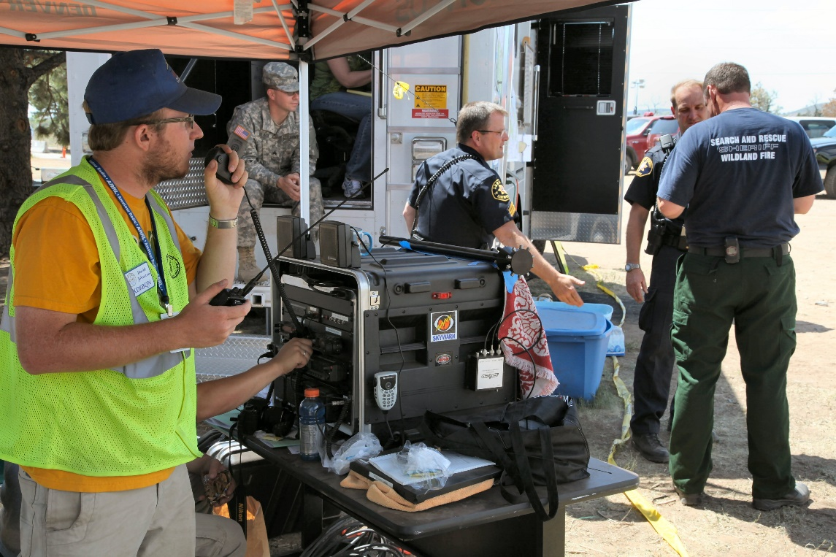
Phonetics
Certain words in a message may not be immediately understood
The best way to be sure it is correctly understood is to spell it
Use the ITU Phonetic Alphabet unless the served agency
requests that you
use their
standardized
phonetic alphabet

Slide 10
Phonetics
Numbers are always pronounced individually
The number “sixty” is pronounced as “six zero”
Standard practice for unusual words
Say the word
Say “I spell”
Spell the word phonetically

Slide 11
Pro-words
Pro-words are procedural terms with specific meanings
Called “pro-signs” when sent in Morse code or digital modes
Over – Used to let a specific station know to respond
Go ahead – Used to indicate that a station may send their message
Clear – End of Contact

Slide 12
Pro-words
Out – Leaving the air, will not be listening
Stand by – A temporary interruption of the contact
Roger – Indicates that a transmission has been received correctly and in full
Break – Indicates that you have more to say after a brief pause or are starting another line/section of the message

Slide 13
Tactical Call Signs
Tactical call signs can identify the station’s location or its purpose during an event, regardless of who is operating the station
It virtually eliminates confusion at shift changes or at stations with multiple operators
Tactical call signs should be used for all emergency nets and public service events if there are more than just a few participants

Slide 14
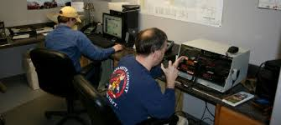
Tactical Call Signs
Tactical call signs are usually pre-assigned by the served agency
However, if one does not already exist, the NCS may assign a tactical call sign as each location is “opened”
“Net” or “Net Control” or “NCS” is a very common tactical call sign

Slide 15
Calling with Tactical Call Signs
In a directed net “AID 3” calls the NCS
“Net, AID 3,”
“AID3”
busy net where the NCS is paying close attention
“Aid 3, emergency traffic”
“Aid 3, priority traffic”

Slide 16
Calling with Tactical Call Signs
To pass traffic to a specific station
“AID 3, traffic for Firebase 5”
NCS will then correctly direct the message
“Firebase 5, contact AID 3 for traffic”
You have quickly connected to the proper station and have not used any extra words
Note that no FCC call signs have been used - so far...

Slide 17
Station Identification
The FCC requires that you identify
Ten-minute intervals during a conversation
End of the last transmission
The easiest way is to give your FCC call sign as you complete each exchange
“Aid 3, <your call sign>”
This does two things
Tells NCS that you consider the exchange complete
Fulfills all FCC identification requirements

Slide 18
Completing a Call
If the Net Control Station believes the exchange is complete, and Aid 3 had forgotten to identify, then the NCS should say
“Aid 3, do you have further traffic?”
At that point, Aid 3 should either continue with the traffic
Clear by identifying
“Aid 3, <your call sign>”
For this method to work properly, the NCS must allow each station the opportunity to identify at the close of an exchange

Slide 19
A Review of Habits to Avoid
Thinking aloud on the air: “Ahhh, let me see. Hmm. Well, you know, if…”
On-air arguments, criticism, or rambling commentaries
Shouting into your microphone
“Cute” phonetics
Identifying every time you key or un-key the mic

Slide 20
A Review of Habits to Avoid
Using “10” codes, Q-signals on phone, or anything other than “plain language”
Speaking without planning your message in advance
Talking just to pass the time

Slide 21
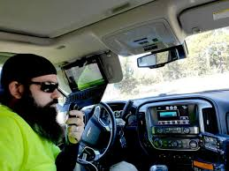
Activity
Looking at the following exchange, think about how you might revise the language to make it more clear and concise

Slide 22
Activity
“K1YZ at Ramapo Base, this is Bob, K2AB at Weston EOC calling.”
“K2AB, this is K1YZ. Hi, Bob. This is Ramapo Base, Harry at the mic. Go ahead. K2AB from K1YZ.”
“K1YZ, this is K2AB returning. Hi, Harry. I have a message for you. Oh, by the way, remember to call me later about the club’s Field Day meeting next month. Are you ready to copy the message? K1YZ, this is K2AB, over to you Harry.”

Slide 23
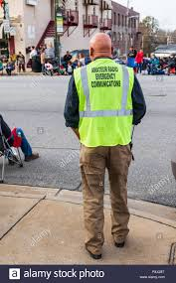
Activity
This should be as simple as
“Ramapo Base from Weston EOC, Traffic”
“Ready To Copy, Over” or “Go Ahead”

Slide 24
Review
Clear, concise communications save time, and reduce misunderstandings
Avoid any non-essential transmissions
Use tactical call signs to call other stations, and give your FCC call sign only at the end of the complete exchange, or every ten minutes during longer exchanges
Plain language is more easily understood by a wider range of people than most codes and jargon

Slide 25
Review
Clear, concise communications save time, and reduce misunderstandings
Avoid any non-essential transmissions
Use tactical call signs to call other stations, and give your FCC call sign only at the end of the complete exchange, or every ten minutes during longer exchanges
Plain language is more easily understood by a wider range of people than most codes and jargon

Slide 26
Basic Communication Skills for Emergency Operations
QUESTIONS?
Clint Miller KØGR, COML
Story County ARES
October 1st, 2020

