Slide 1
ARES task book, emergency preparedness, and go-kits
Clint Miller
Story County Emergency Coordinator
Amateur Radio Emergency Service

Slide 6
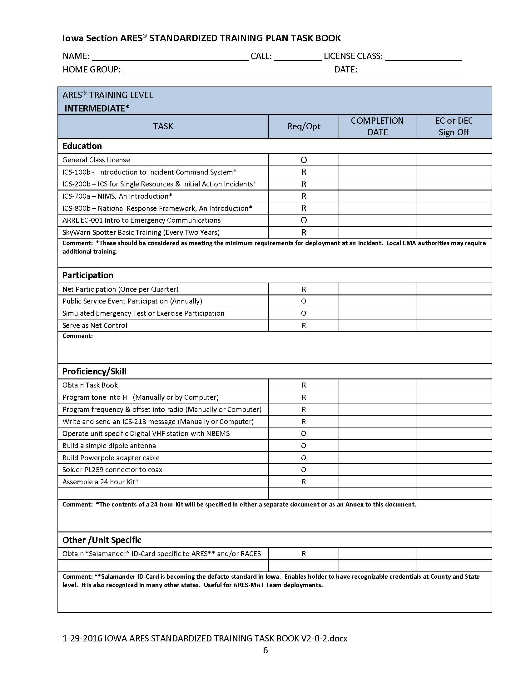

Slide 7
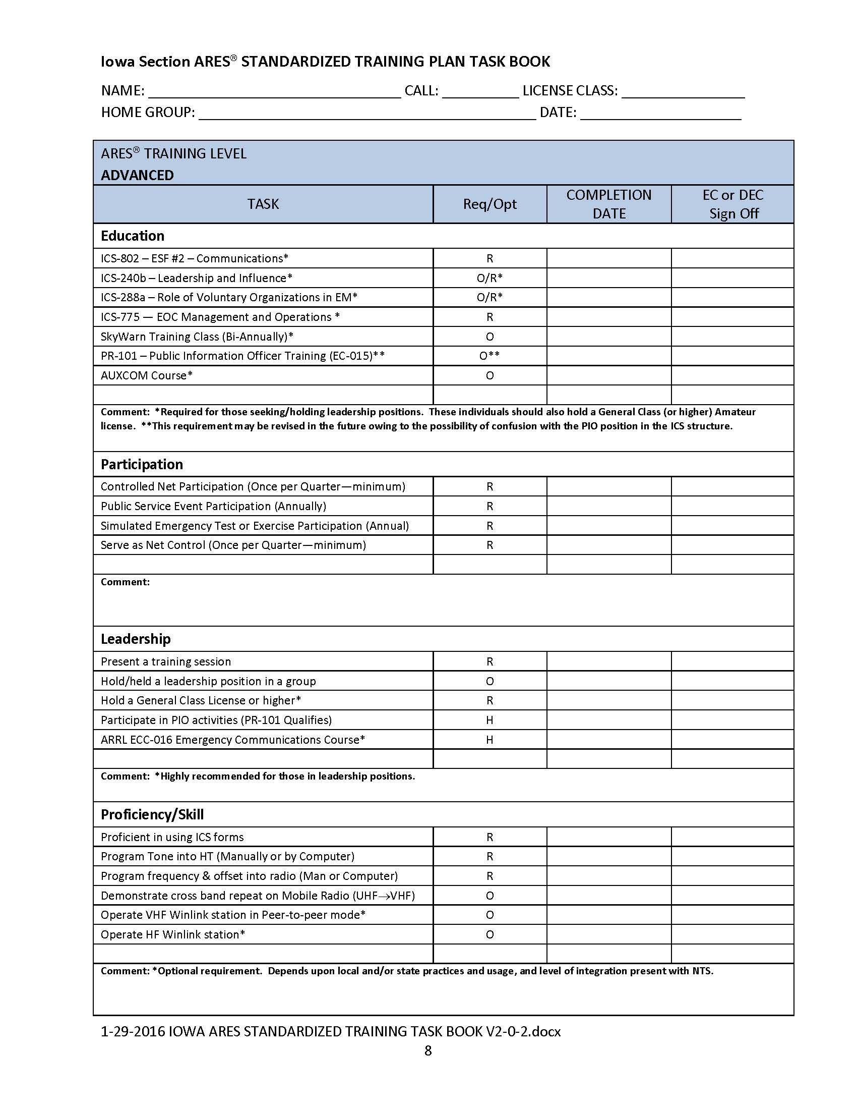

Slide 8
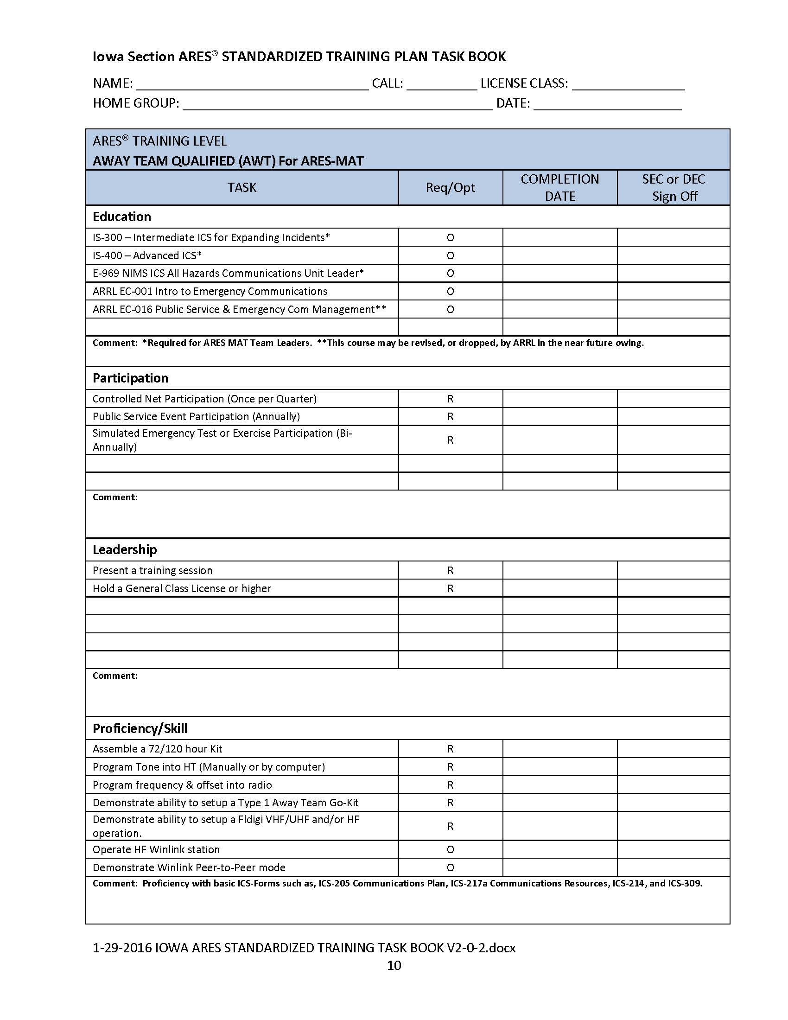

Slide 9
Emergency Preparedness
Before you can respond as an ARES volunteer, you must first make sure you and your family are safe and secure
Proper planning will help ensure that you will be prepared for any emergency
You must have the tools and plans in place to make it on our own, at least for a period of time, no matter where you are when disaster strikes
Just like having a working smoke detector, preparing for the unexpected makes sense

Slide 10
U.S. Homeland Security 3 Key Recommendations
Get an emergency supply kit
Make a family emergency plan
Be informed about the different types of emergencies that could occur and the appropriate responses

Slide 11
Family Emergency Supply Kit
All Americans should have some basic supplies on hand in order to survive for at least three days if an emergency occurs
Review the list and consider where you live and the unique needs of your family
Consider having at least two emergency supply kits
one full kit at home
smaller portable kits in your workplace, vehicle or other places you spend time

Slide 12
Recommended Items to Include in a Basic Emergency Supply Kit:
Water
one gallon of water per person per day for at least three days, for drinking and sanitation
Food
at least a three-day supply of non-perishable food
Battery-powered or hand crank radio and a NOAA Weather Radio with tone alert
extra batteries for both
Flashlight and extra batteries
First aid kit

Slide 13
Recommended Items to Include in a Basic Emergency Supply Kit:
Whistle to signal for help
Dust mask, to help filter contaminated air
Plastic sheeting and duct tape to shelter-in-place
Moist towelettes, garbage bags and plastic ties for personal sanitation
Wrench or pliers to turn off utilities
Can opener for food (if kit contains canned food)
Local maps

Slide 14
Additional Items to Consider Adding to an Emergency Supply Kit:
Prescription medications and glasses
Infant formula and diapers
Pet food and extra water for your pet
Important family documents
copies of insurance policies, driver’s license, Social Security card, wills, deeds and bank records in a waterproof, portable container
Cash or traveler’s checks and change
Printed emergency reference material
first aid book or information from www.ready.gov
Sleeping bag or warm blanket for each person
may not be enough during an Iowa blizzard!
Complete change of clothing including a long sleeved shirt, long pants and sturdy shoes (consider cold weather gear)

Slide 15
Additional Items to Consider Adding to an Emergency Supply Kit:
Household chlorine bleach and medicine dropper
When diluted nine parts water to one part bleach, bleach can be used as a disinfectant
In an emergency, you can use it to treat water by using 16 drops of regular household liquid bleach per gallon of water
Do not use scented, color safe or bleaches with added cleaners
Fire Extinguisher
Matches in a waterproof container
Feminine supplies and personal hygiene items
Mess kits, paper cups, plates and plastic utensils, paper towels
Paper and pencil
Books, games, puzzles or other activities for children

Slide 16
Even More Items to Consider Adding to an Emergency Supply Kit:
Cell phone charger
Cord, rope, twine
Cooking utensils
Emergency stove, fuel, and cooking pot
Insect repellent
Lantern
Playing cards or other entertainment
Pry bar
Sewing kit
Tent
Water filters

Slide 17
Grab and Go 72 Hour Kit (Bug Out Bag)
Assemble items in a sturdy container that is easy to transport
Backpack or duffel bag
New trash can
Plastic storage box with wheels
Store the kit near the door most likely used to evacuate
Rotate food and other items with expiration dates
Consider keeping additional two week supply of food and water for sheltering in place

Slide 18
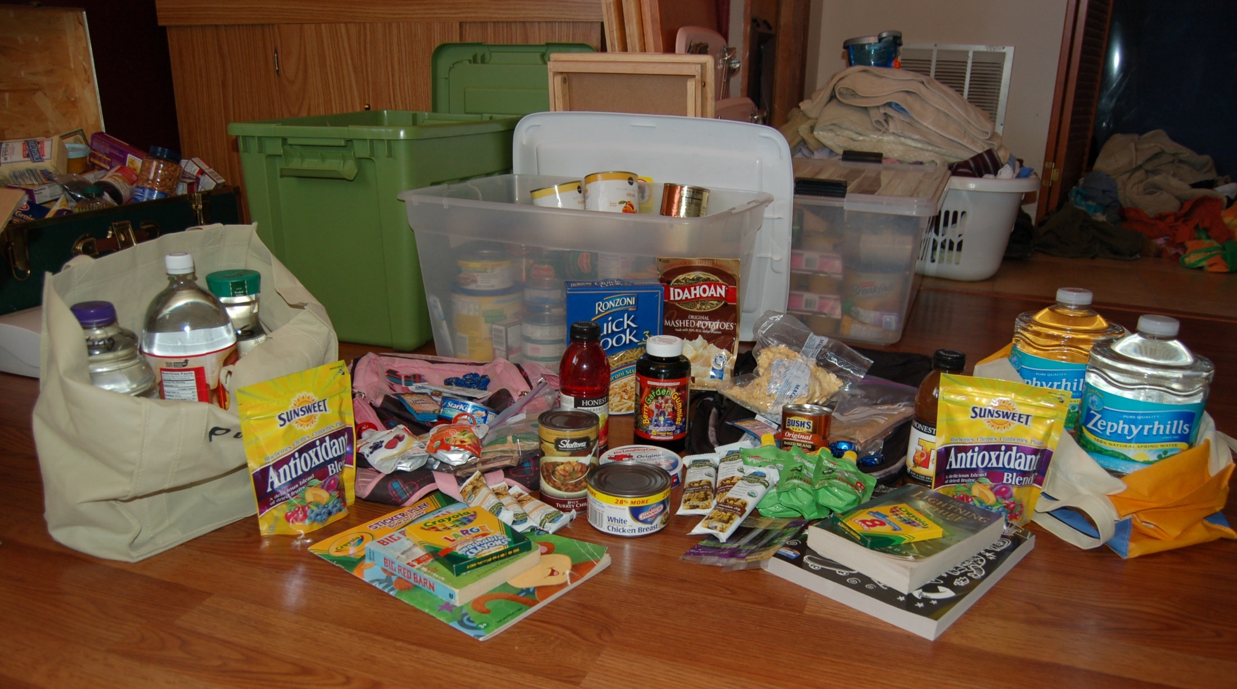
Grab and Go 72 Hour Kit

Slide 19
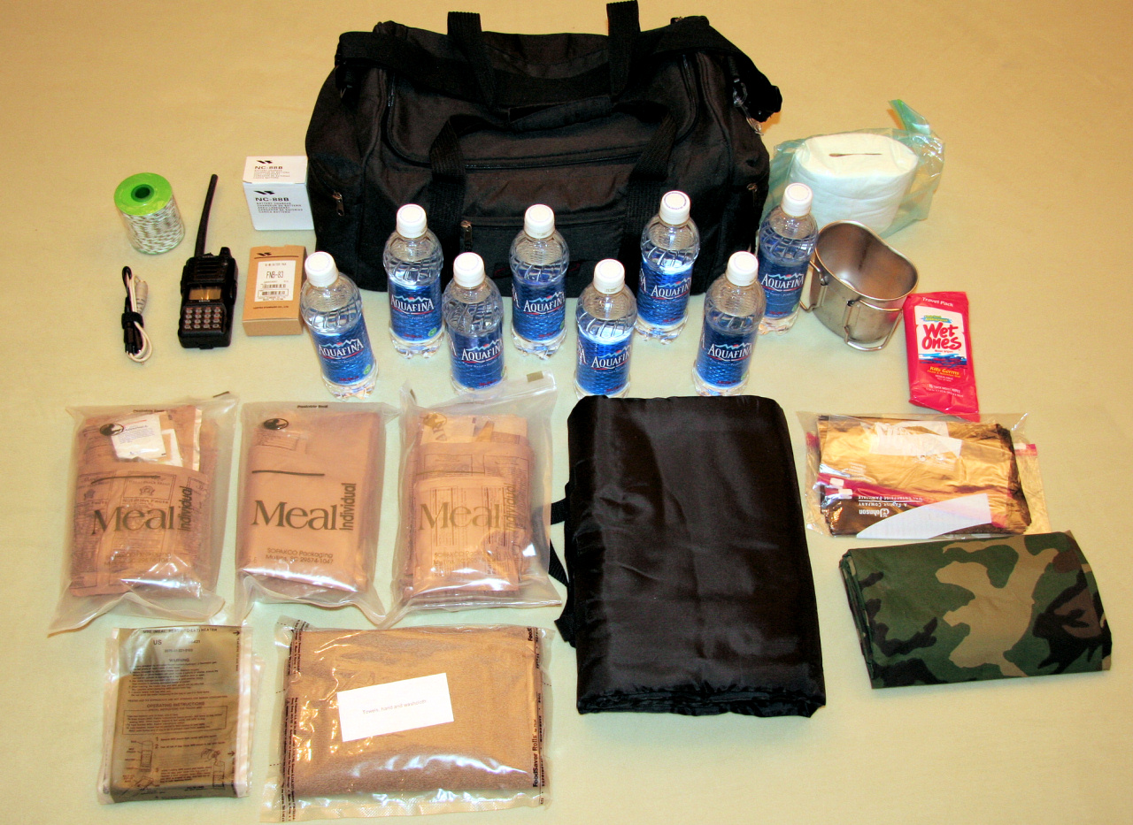
Grab and Go 72 Hour Kit

Slide 20
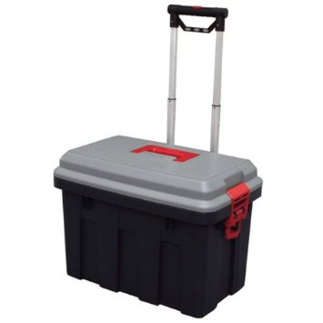
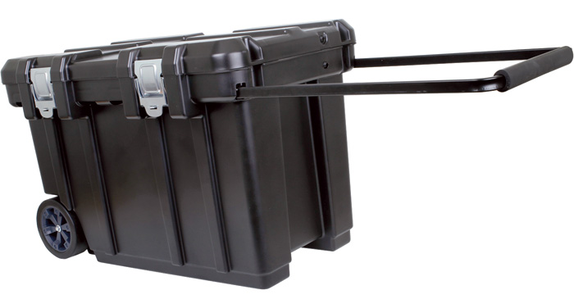
Grab and Go 72 Hour Kit

Slide 21
Family Disaster Plan
Neighborhood, Out-of-Neighborhood, and Out-of-Town Meeting Places
Info about each Family Member
DOB, SSN, Phone Numbers, Medical Info
Important Family Locations
Insurance Policy Info and Phone Numbers
Wallet Card for each Family Member
Know who to call and where to meet in case of an emergency

Slide 23
Be Informed
storycountyiowa.gov/ema
fema.gov
ready.gov
iowahomelandsecurity.org
beready.iowa.gov
redcross.org
preparednessnow.org
willowhavenoutdoor.com
zombiehunters.org

Slide 24
STORY COUNTY HAZARD MITIGATION PLAN

Slide 27
Now That Your Family is Prepared…
Emcomm volunteers also need to consider the potential hazards when planning their equipment and supplies
AC power, or just the batteries you bring?
Safe drinking water, or only what’s in your water bottles?
Outdoor location, or deep inside a structure?
Repeaters, or simplex only?
Conditions are not always know in advance, particularly during the early stages of an emergency

Slide 28
Being prepared for an emergency communication deployment
Involves a wide range of considerations
Radio equipment
Power sources
Clothing and personal gear
Food and water
Specialized training
Served agency needs
There is no one size fits all checklist

Slide 29
Go Kits
Also known as a "jump kit"
Last thing you should need to do when a call for assistance comes is think of and locate all the items you might need
Any experienced emergency responder knows how important it is to keep a kit of the items they need ready to go at a moment's notice

Slide 30
Without a Go Kit
You will almost certainly leave something important at home
Bring items that will not do the job
Gathering and packing your equipment at the last moment also wastes precious time
Think through each probable deployment ahead of time, and the range of situations you might encounter

Slide 31
Iowa ARES Emergency Communications Plan
“Each member should assemble a 24-hour go kit to allow them to rapidly respond to local emergencies. Each is also encouraged to develop a 72-hour go kit to allow response to longer-term emergencies. Members of ARES Mutual Assistance Teams must maintain such a 72-hour go kit. Suggested contents of such kits are described in the AECCC Level I course.”

Slide 32
Basic Questions to Answer
Which networks will you need to join, and which equipment will you need to do so?
Will you need to be able to relocate quickly, or can you bring a ton of gear?
Will you be on foot, or near your vehicle?
Is your assignment at a fixed location or will you be mobile?
How long might you be deployed - less than 48 hours, up to 72 hours, or even a week or more?

Slide 33
Basic Questions to Answer
Will you be in a building with reliable power and working toilets, or in a tent away from civilization?
What sort of weather or other conditions might be encountered?
Where will food and water come from? Are sanitary facilities available?
Will there be a place to sleep?
Do you need to plan for a wide variety of possible scenarios, or only a few?
Can some items do “double duty” to save space and weight?

Slide 34
“But I’ll never use …”
Don’t get fixated on one particular situation you think you will respond to
Different types of disasters can put you in entirely different situations, in different locations with different infrastructure availability in different weather conditions
Extreme heat vs. extreme cold
Dry weather vs. wet weather vs. ice and snow
Available AC power vs. power outage for a week
Full blown disaster vs. simple labor requests
The goal here is to plan to have a kit that will cover you for the widest possible range of situations.
Be flexible!

Slide 35
Your Go Kit Preference
Everyone has their own favorite list of items to keep in a go kit
Some are detailed, others more general
Some responders have more than one kit for different types of deployments
You will need to develop your own, suited to your own needs
There is a general list on the following slides to help you get started
Depending on your situation, you may not need some of the items on this list, or you may need special items not listed

Slide 36
Go Kit Idea List
Something to put it in -- one or more backpacks, suitcases, plastic storage tubs, etc
Package individual items in zip lock bags or plastic kitchen containers
Label all items in case you loan or forget something

Slide 37
Divide up your Go Kit
Create a personal go kit for your own needs
Could be a component of your Grab and Go 72 Hour Emergency Supply Kit
Create one of more radio go kits for your communication needs
HT Kit for “shadow” assignments
VHF/UHF Go Kit for fixed location assignments or net control
HF Kit for wide area communications (Field Day)
Pair your personal kit with the radio kit that fits your assignment and you’re fully prepared!

Slide 38
Personal Go Kit
Clothing for the season, weather, and length of deployment
Toilet kit: soap, razor, deodorant, comb, toothbrush, toothpaste, toilet paper
Foul weather or protective gear, warm coats, hats, rain gear
Sleeping bag, closed-cell foam pad or air mattress, pillow, ear plugs, sleeping mask
High energy snacks
Easily prepared dried foods that will store for long periods
Eating and cooking equipment if needed

Slide 39
Personal Go Kit
Water containers, filled before departure if needed
First aid kit, personal medications and prescriptions for up to one week
Money, including a large quantity of quarters or $1 bills for vending machines, laundry, or tolls
Telephone calling card
Personal cell phone, spare batteries and chargers

Slide 40
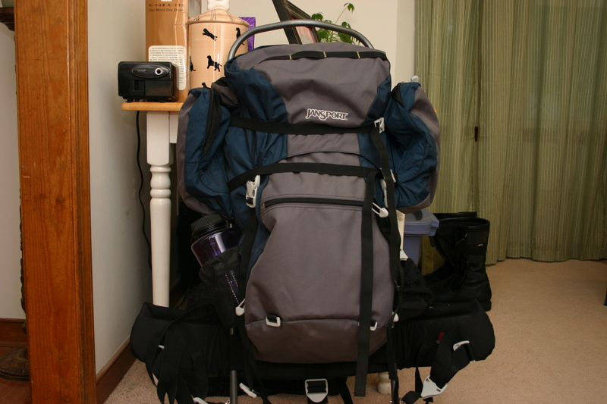
Personal Go Kit

Slide 41
HT Go Kit
Handheld VHF or VHF/UHF
Some people also like to bring a spare
VHF/UHF gain antennas and adapters
roll-up j-pole
mobile magnetic mount
mobile clamp mount with ground plane
Spare rechargeable batteries for handhelds
Alkaline battery pack for handhelds
Alkaline batteries
Speaker mic and earphone or headset for handhelds
Battery chargers, AC and DC for handhelds

Slide 42
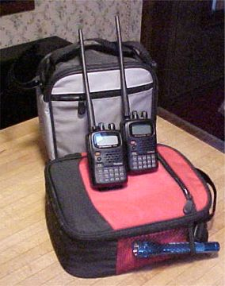
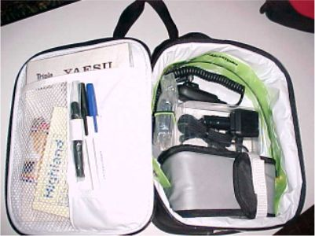
HT Go Kit

Slide 43
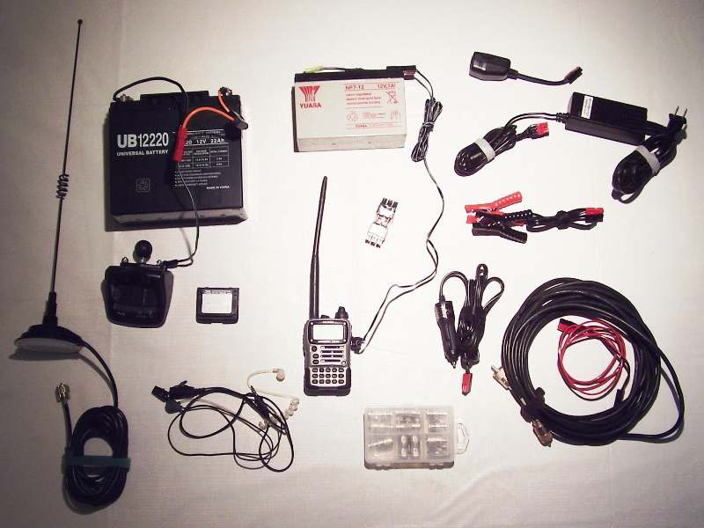
HT Go Kit

Slide 44
Mobile VHF/UHF Go Kit
Mobile VHF or VHF/UHF radios
VHF/UHF gain antennas and adapters
roll-up j-pole
mobile magnetic mount
mobile clamp mount with ground plane
Coaxial feed lines, jumpers
AC power supply for radios and accessories
Large battery source for VHF/UHF mobile with charger
Power, data, audio, and RF cables and adapters
Small repair kit: hand tools, multi-meter, soldering iron, connectors, adapters, fuses, key parts

Slide 45
Mobile VHF/UHF Go Kit

Slide 46
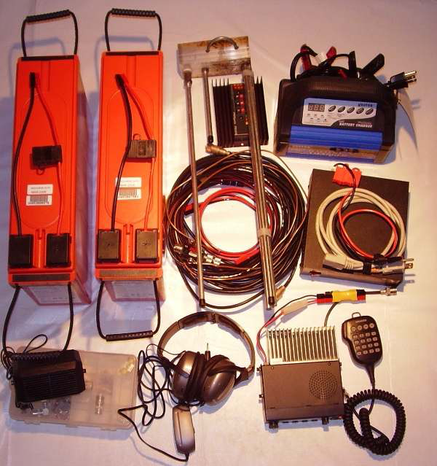
Mobile VHF/UHF Go Kit

Slide 47
Mobile VHF/UHF Go Box

Slide 48
HF Go Kit
HF radio and antenna tuner
Coaxial feed lines, jumpers
AC power supplies for HF radio and accessories
Large battery source for HF radio with charger
Multi-band wire HF antenna, heavy parachute cord or nylon mason's twine
Ground rod, pipe clamp, and wire
Power, data, audio, and RF cables and adapters
Small repair kit: hand tools, multi-meter, soldering iron, connectors, adapters, fuses, key parts

Slide 49
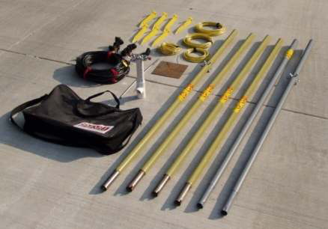
HF Antenna Kit

Slide 50
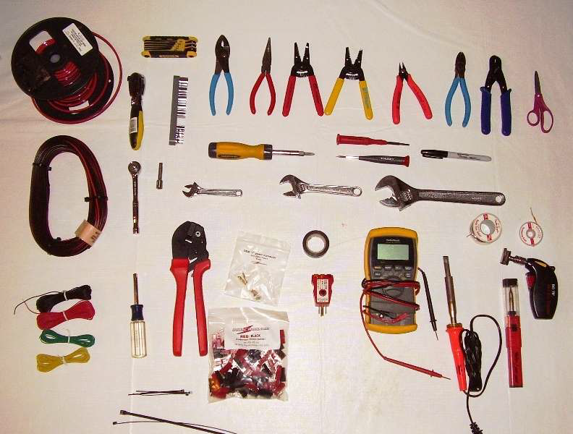
Tool Kit

Slide 51
Radio Go Kit Accessories
Materials for improvisation: wire, connectors, small parts, insulators, duct tape, electrical tape
Photocopies of manuals for all equipment
ARES Manual including standard Radiograms
Headphones for noisy areas and privacy with proper connector, adaptors
Specialized gear for fldigi, ATV or other modes
Multi-band scanner, weather radio
Orange or green vest
Clock or watch

Slide 52
Information Kit
ID cards and other authorizations
Copy of Amateur Radio license
Copies of FEMA Course Certificates
Frequency lists and net schedules
Maps, both street and topographic
Key phone numbers, email and internet addresses
Contact information for other members in your group, EC, AEC, DEC, SEC, and others
Copy of emergency plans
Resource lists: who to call for which kinds of problems

Slide 53
Operating Supplies
Pens, pencils, pencil sharpener
Preprinted Radiogram message forms
Log sheets or book
Preprinted forms used by the served agency
ICS-213
Story Co. Damage Report
Letter or legal size notepads
Sticky notes
Paper clips and rubber bands
Blank envelopes
Stapler and spare staples

Slide 54
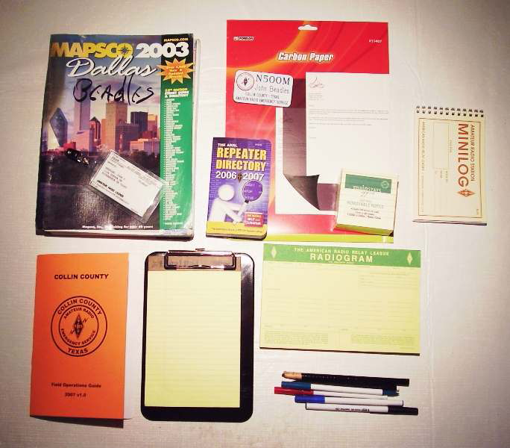

Slide 55
Last Minute Add-in List
You may not want to pre-pack some items
Expense
Shelf life
Daily use
Keep a durable checklist of these items in your go kit so that you will remember to add them at the last minute

Slide 56
Pre-Planning
When activated, know where to go and what to do
Having this information readily available will help you respond more quickly and effectively
It will not always be possible to know these things in advance, particularly if you do not have a specific assignment
Answering the following basic questions may help:
Which frequency should you check in on initially? Is there a "backup" frequency?
If a repeater is out of service, which simplex frequency is used for the net?
Should you report to a pre-determined location or will your assignment be made as needed?

Slide 57
Training & Education
The more you know, the more effective and valuable you will be
ARRL EC-001 Introduction to Emergency Communication
ICS-100 Introduction to Incident Command System
IS-700 National Incident Management System (NIMS) An Introduction
IS-200 ICS for Single Resources and Initial Action Incidents
IS-775 EOC Management and Operations
Take served agency job-specific training
Learn how the served agency's organization works
Learn their needs and how you can best meet them

Slide 58
American Red Cross Classes
Self-study or classroom courses
Mass Care
Damage Assessment
Sheltering

Slide 59
Local ARES Training
General or agency-specific training in message handling and net operations under emergency conditions
Become familiar with ARES equipment setup and operation in the field
On your own, set up and test your personal equipment under field conditions to be sure it works as expected

Slide 60
Drills and Exercises
Participate in any drills or exercises offered in your area
Some are designed to introduce or test specific skills or systems, others to test the entire response
ARRL's Field Day
Simulated Emergency Test
Story County Coalition for Disaster Recovery

Slide 61
Reference links:
Story County ARES Emergency Operations Plan storyares.org
ARES Field Resources Manual www.arrl.org/files/file/ARES_FR_Manual.pdf
ARES Manual www.arrl.org/files/file/Public%20Service/ARES/ARESmanual2015.pdf
ARES Monthly E-Letter www.arrl.org/ares-el
ARRL Public Service/Field Services Forms www.arrl.org/public-service-field-services-form
July 2006 QST article archive: Survival Packs, Jump Kits and Tool Bags

Slide 62
Reference links:
Federal Emergency Management Agency - Emergency Management Institute: training.fema.gov/is
American Red Cross Classes www.redcross.org/take-a-class

Slide 63
Review:
If your family is prepared, then you are more likely to respond and focus on your assignment
Pre-planning and physical preparation are essential to an effective and timely emergency response
Keep a stocked and updated "go kit" ready to go at a moments notice
Be sure your kit is adequate for the types of deployments you are most likely to encounter
Information is as important as equipment
Know in advance where are you are going, and what you will do when you get there
Keep updated lists of contact information, frequencies, and other resources on hand as well as copies of all emcomm pre-plans

Slide 64
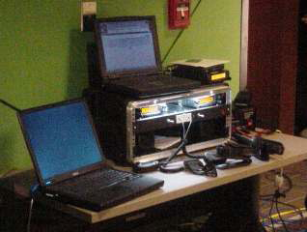
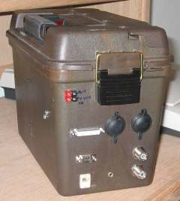
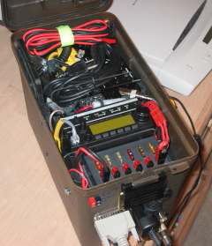

Slide 65
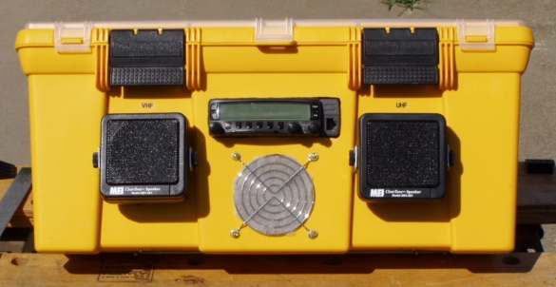
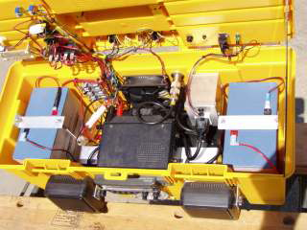

Slide 66
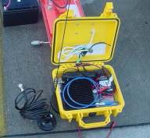
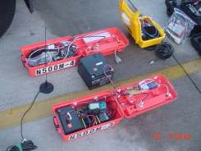
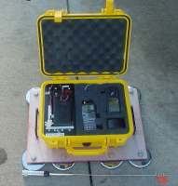
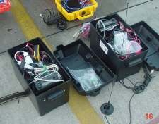
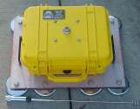

Slide 67
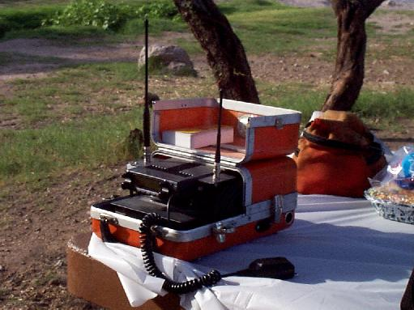

Slide 68
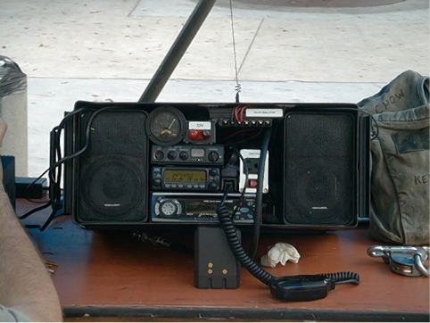

Slide 69
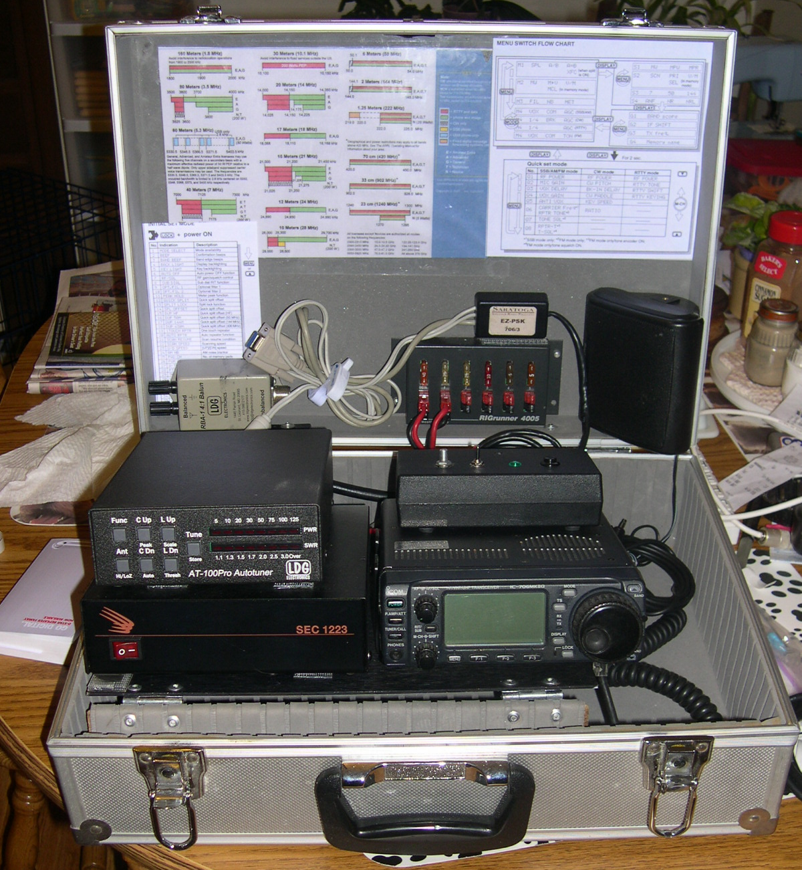

Slide 70
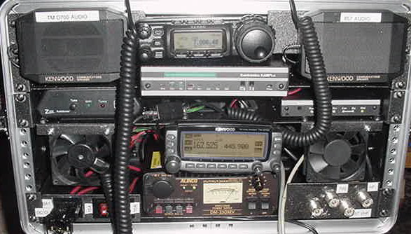

Slide 71
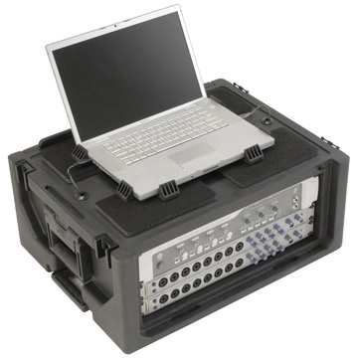
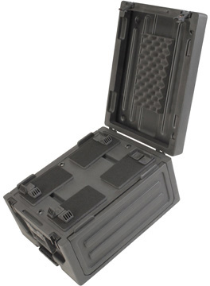
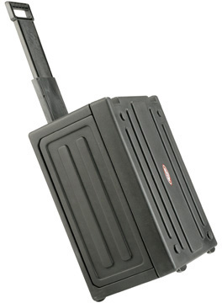
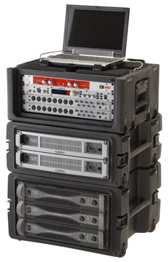

Slide 72
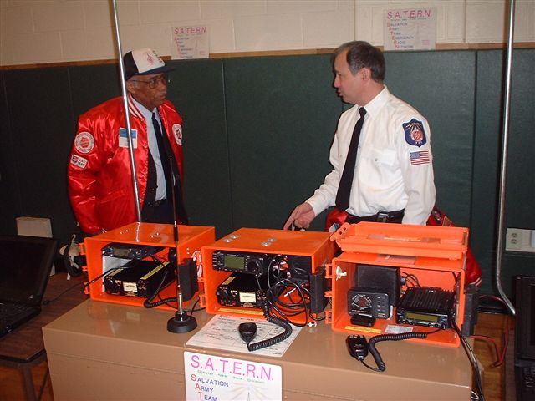

Slide 73
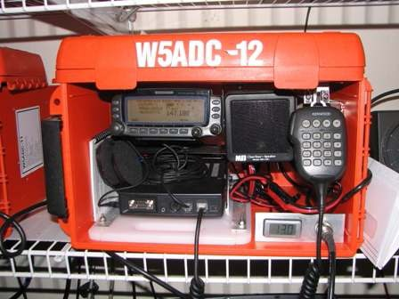
Voice & APRS Station

Slide 74
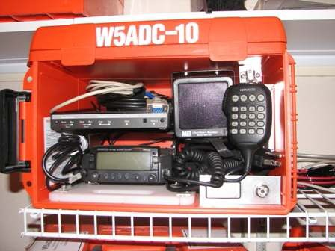

Slide 75
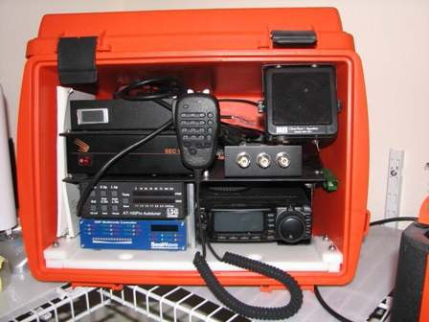
HF Station

Slide 76
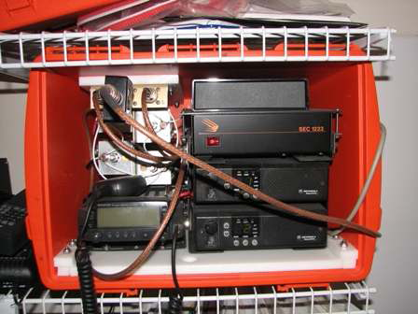
Emergency UHF Repeater

Slide 77
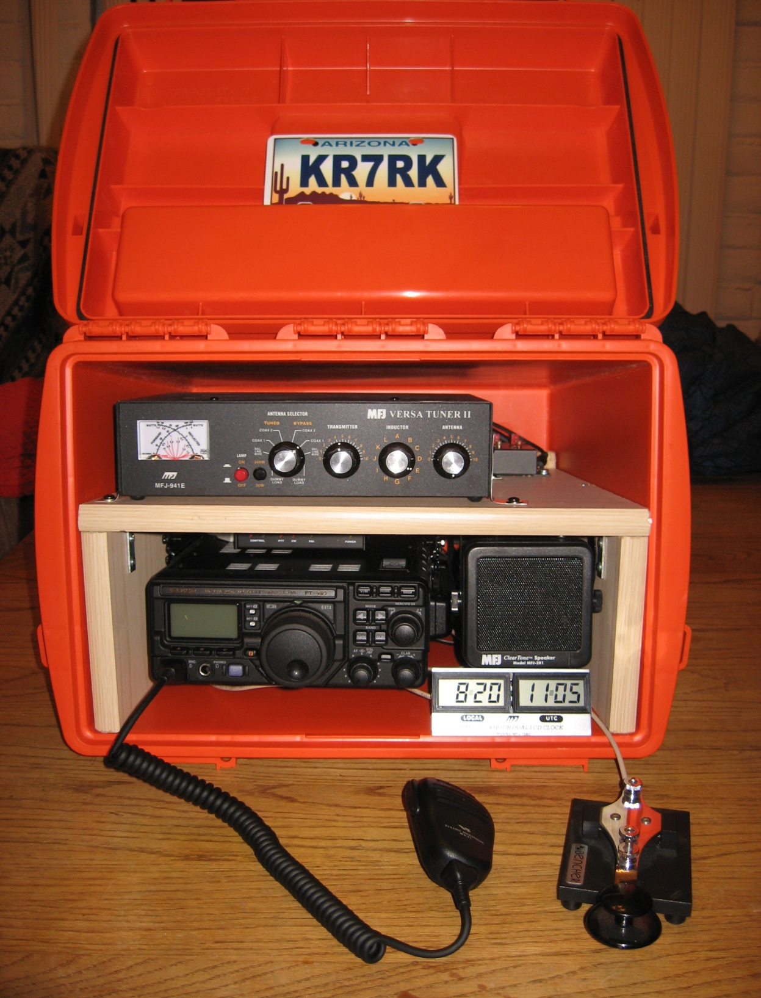

Slide 78
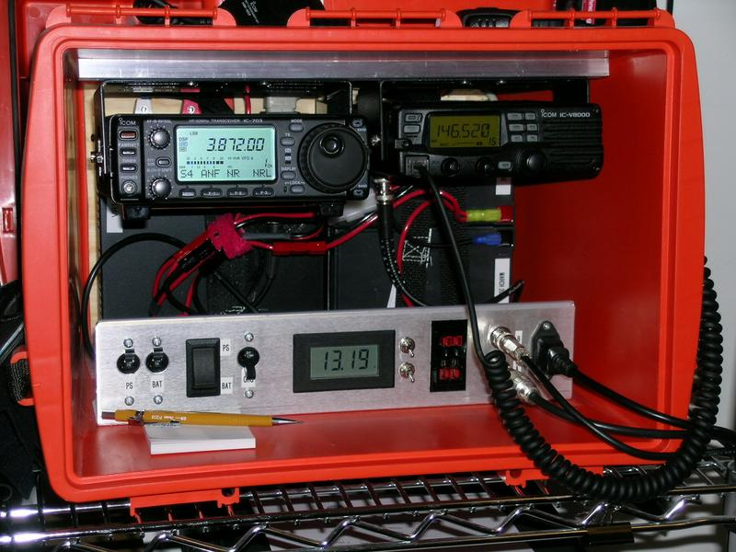

Slide 79
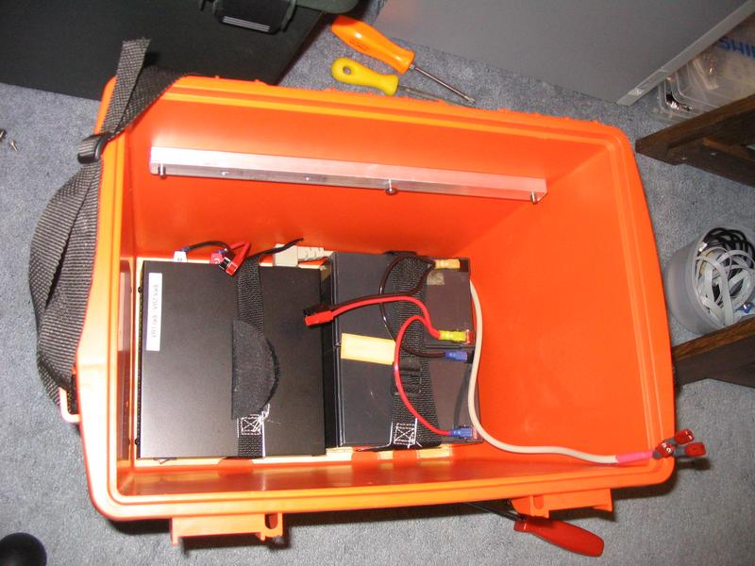

Slide 80
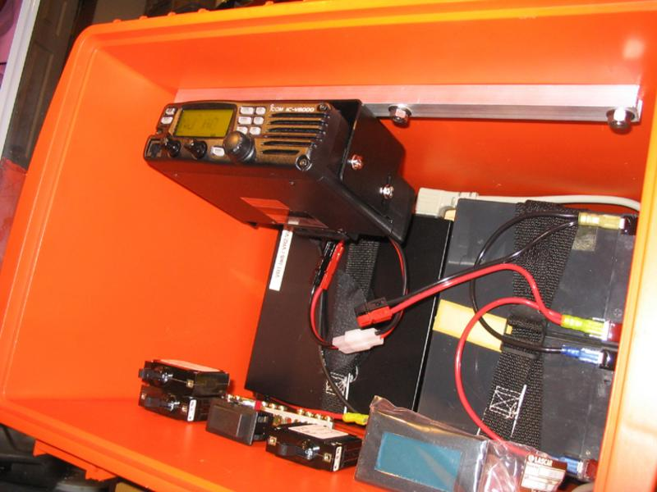

Slide 81
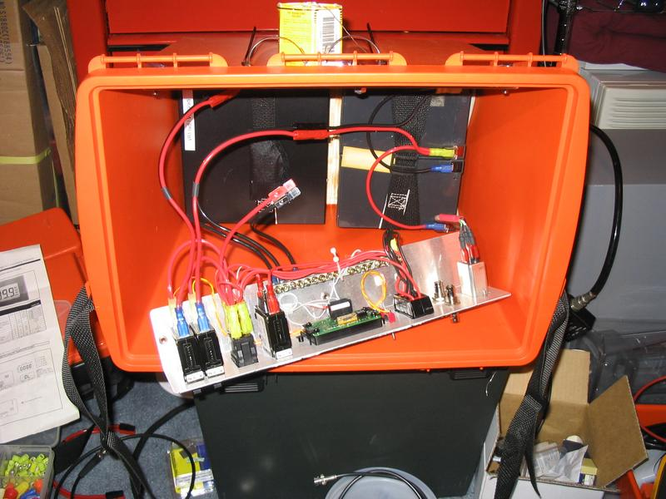

Slide 82
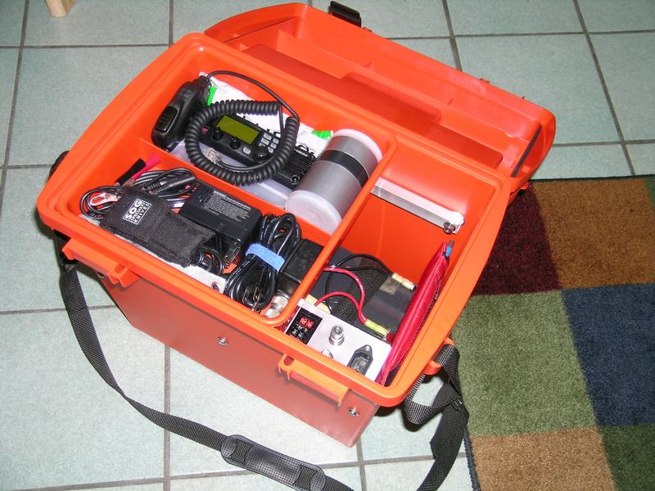

Slide 83
