Slide 1
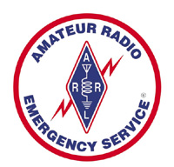
12 Volt wiring and Powerpoles
Clint Miller KCØJUO
Story County EC
January 7th, 2015

Slide 2
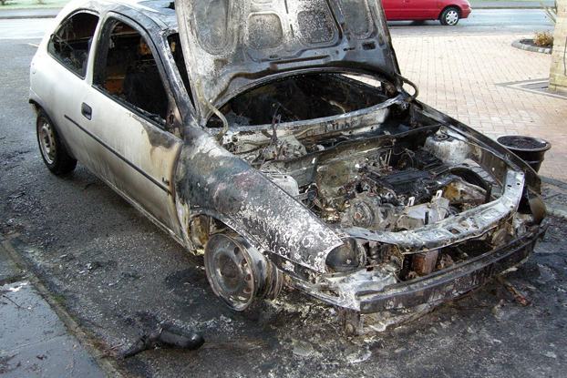
Wiring Amateur Gear
Choosing proper wiring and connectors can protect equipment from poor performance, damage, and a potentially catastrophic fire.

Slide 3
Vehicle Wiring
Never, ever use existing vehicle wiring to power any amateur radio gear.
This includes fuse taps and so-called accessory sockets, aka cigarette lighter sockets!
From the National Fire Protection Association, sub-section 15-3.2.1:
  Overloaded Wiring. Unintended high-resistance faults in wiring can raise the conductor temperature to the ignition point of the insulation, particularly in bundled cables such as the wiring harnesses or the accessory wiring under the dash where the heat generated is not readily dissipated. This can occur without activating the circuit protection.

Slide 4
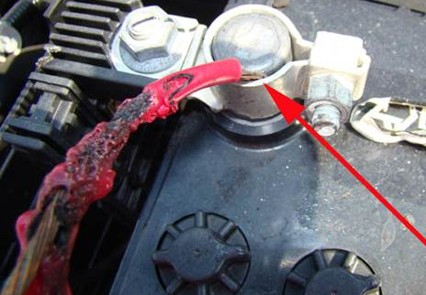
Vehicle Wiring
The process is called thermolysis (aka pyrolysis).
  Decomposition of the insulation covering the wire, brought about by high temperatures
  Resistive heating in other words
Thermolysis may occur within a few minutes, or over an extended length of time.

Slide 5
Vehicle Wiring
Manufacturers of transceivers have always recommended direct to battery connections.
Wiring in this fashion eliminates the extra voltage drop caused by using the chassis as a ground return.
It also prevents ground loop interference to on-board CPUs, remote sensors, and data buses.
Fuses must be installed in both leads!
The negative lead fuse protects the transceiver in the rare case of a negative starter lead failure.

Slide 6
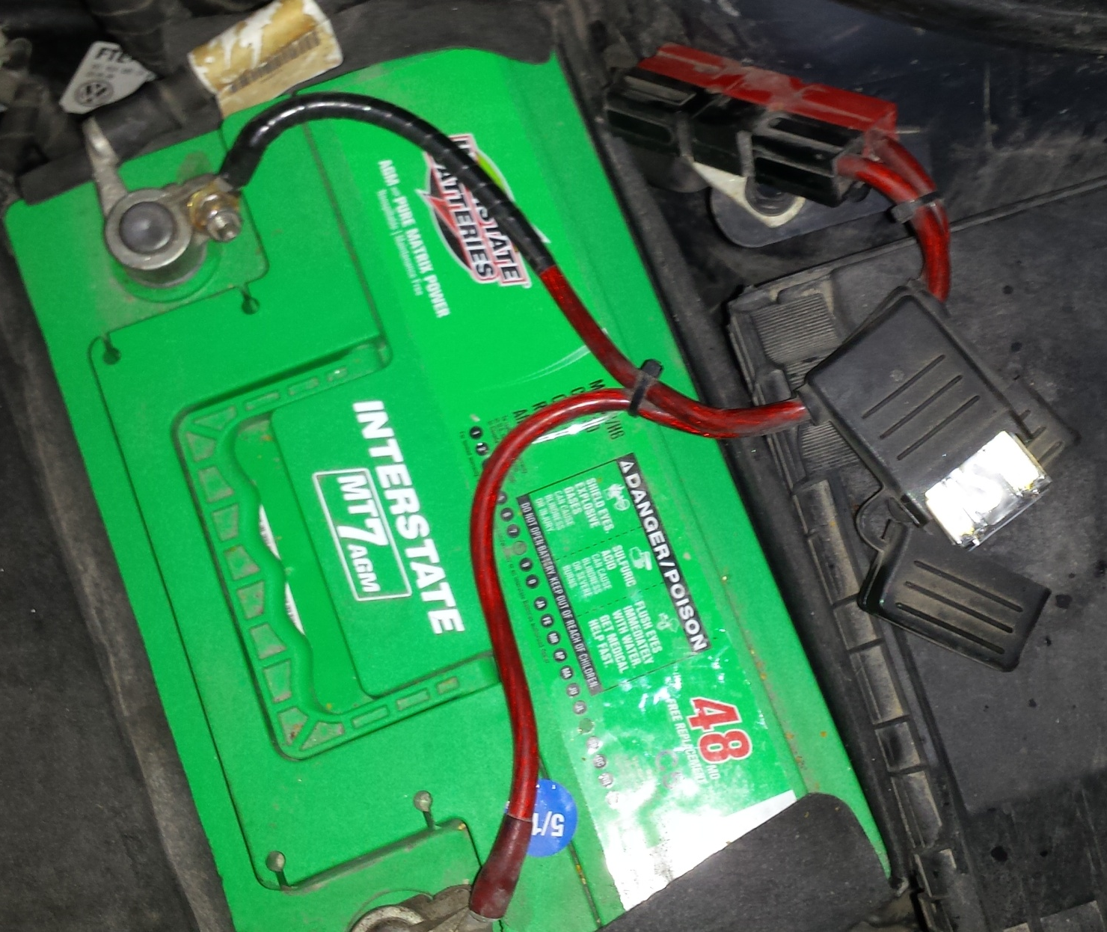
Vehicle Wiring

Slide 7
What Size Wire To Use
Most solid state transceivers are factory supplied with a 10 foot (3 meter) long power cable.
2.5 mm diameter wire, it is slightly smaller than #10 AWG.
On average, the voltage drop through a stock power cable is ≈.6 volts (22 amps), which is slightly over the recommendation of .5 volts or less.
This presents an enigma when using factory cables.
The best solution is to replace the factory cable with a home brewed one, using a larger wire size.
An alternative is to shorten the factory cable so the total voltage drop is .5 or less.

Slide 8
What Size Wire To Use
The primary basis for selecting the correct wire size is not its current handling capability.
Rather, it is based on the voltage, drop under the impressed load, over the length in question.
It should always be based on the peak current draw, not the average.
It is always best to error on the safe side when it comes to voltage drop.
Selecting the next larger size wire doesn't double the cost of the wire or that of the connectors.

Slide 9
What Size Wire To Use
Modern amateur mobile transceivers universally operate on a nominal 13.8 vdc.
In a mobile scenario, the DC voltage actually varies from below battery resting voltage (≈12.2), to as high as 14.4 when the alternator is charging the battery.
If we allow the voltage to drop much lower than 12.2, most transceivers will simply shut off.
At low voltages the power output drops and the intermodulation distortion increases.
To minimize the voltage drop in our wiring, we need to know the peak current draw.
The manufacturer's published figures are close enough.

Slide 10
What Size Wire To Use
For an average 100 watt (200 watts input) transceiver, the peak current is approximately 22 amps which includes some parasitic draw like the cooling fan.
A 50 watt FM transceiver is about half that or 11 amps.
Assume 10 feet from battery to mounting position.

Slide 11
Wire Gauge Selection Table
12 Volt Circuit

Slide 12
Calculating Voltage Drop
Here is the formula for calculating the voltage drop for any given size and length of wire including the slight drop due to the fuses and their holders…

Slide 13
Voltage Drop Formula
[(Rw • 2l • .001) + 2k] • A = Vd where:
  Rw = 1,000 foot resistive value from ARRL Handbook
    #12=1.588Ω, #10=.9987Ω, #8=.6281Ω, #6=.3952Ω, #4=.2485Ω, #2=.1563Ω
  l = Overall length of cable assembly including connectors.
  k = nominal resistive value for one fuse and its holder.
    If you don't know the fuse and holder resistance, use a conservative value of .002 ohms.
    You should also add in the voltage drop across any Anderson Power Pole connection. On average, that .002 volts per connection, at rated load.
  A = Peak current draw in amperes.
  Vd = Cable assembly voltage drop.

Slide 14
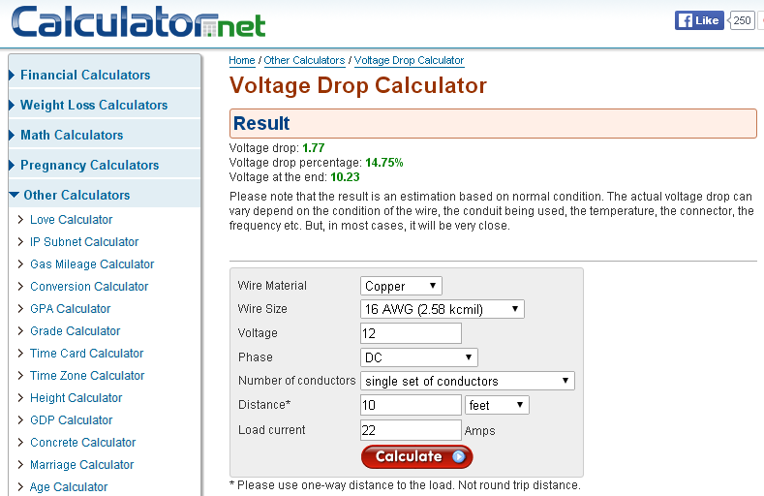
Online Voltage Drop Calculator

Slide 15
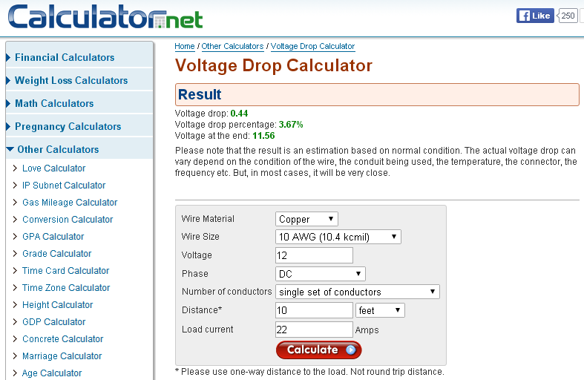
Online Voltage Drop Calculator

Slide 16
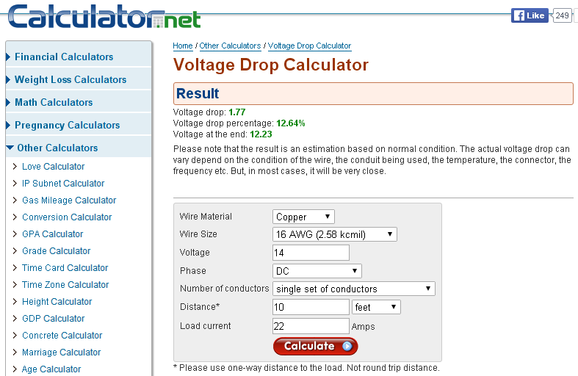
Online Voltage Drop Calculator

Slide 17
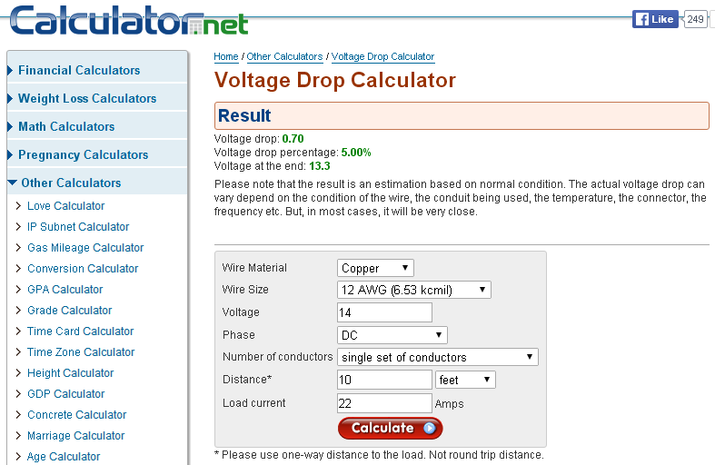
Online Voltage Drop Calculator

Slide 18
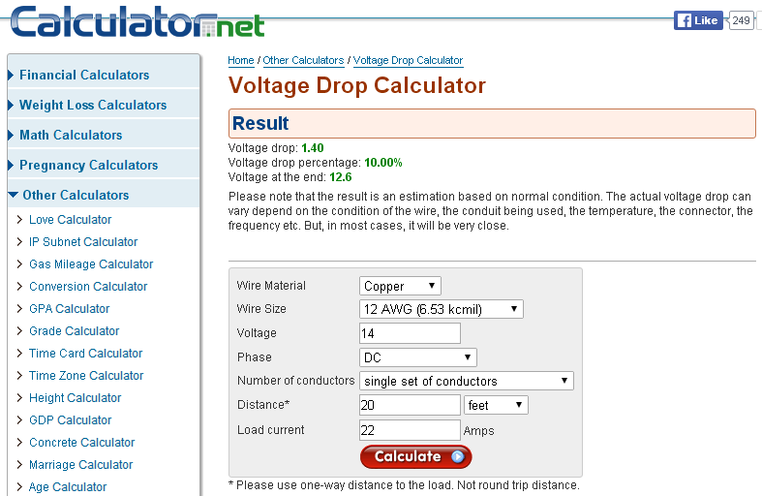
Online Voltage Drop Calculator

Slide 19
Online Voltage Drop Calculator
www.calculator.net/voltage-drop-calculator.html
Most on-line calculators do not take into account the voltage drop across the fuses.
  A 30 amp ATC fuse has a voltage drop of 95 mV (.095 volts) at rated load.
  A 60 amp Maxi fuse has a voltage drop of 77 mV (.077 volts) at rated load.
Another reason to shoot for less voltage drop is temperature rise.
  Since an automotive environment is hotter than a base station one, over-sizing the wire (less resistance) will keep temperature rise to a minimum.
  Too high a temperature rise, and the insulation could melt (pyrolysis).

Slide 20
Other Wiring Considerations
Any excess wire should be cut off, not bundled up with a cable tie—think voltage drop!
Insulation Temperature Rating
  195°F in the passenger compartment
  220°F in the engine compartment
Abrasion Resistance
  THHN and THWN wire has an outer nylon jacket making them very abrasion resistant.
  Construction grade wire is almost always 7 or 19 strand (depending on the wire size), and rather stiff.

Slide 21
Wire Choices
High strand count super-flex wire like that sold at mobile sound stores is almost too flexible and you must use crimp-type connectors – too hard to solder.
Automotive wire is usually 49 strand, is much easier to work with, and will generally stay where you put it.
  You should still use cable ties to keep it in place.
Cross-Linked polyethylene (XLP), and Polyvinyl Chloride (PVC) are both acceptable products, if they're rated at 195°F or higher.
Most after-market sound-system wire is insulated with Polyethylene, an inexpensive thermoplastic.
  It is moisture resistant, but its poor heat and flame resistance makes it a poor choice for mobile installations.

Slide 22
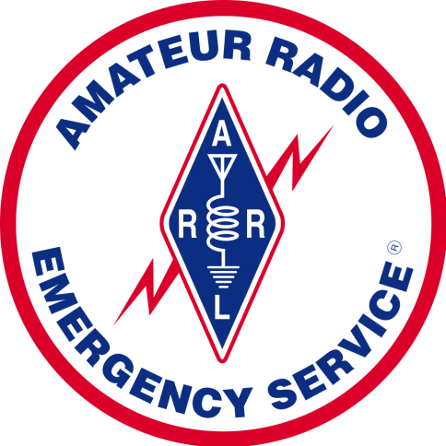

12 Volt DC Connectors
A multitude of 12V DC electrical connectors are in use, but no standard exists.
A standardized 12V DC electrical connector must be adopted by emergency response units.
DC Power Connection Requirements:
  Standardized
  Polarized
  Current Rated
  Protected from shorts
  Easy to use
  Easy to build

Slide 23
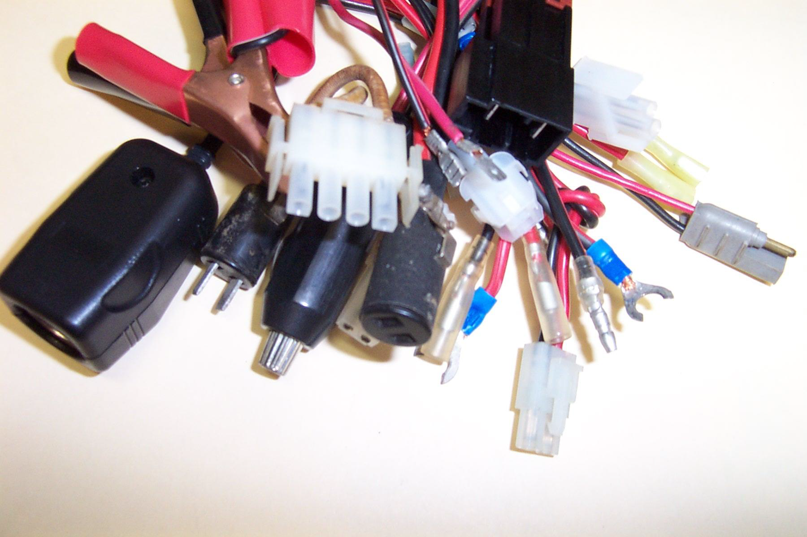
The Problem…
No Standard
Equipment could not be easily moved and redeployed
Different connector for supply and load

Slide 24
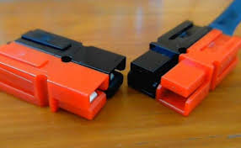
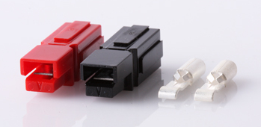
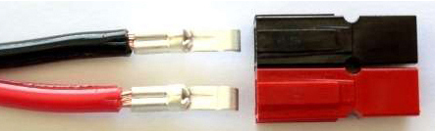

The Solution!
Anderson Powerpoles

Slide 25
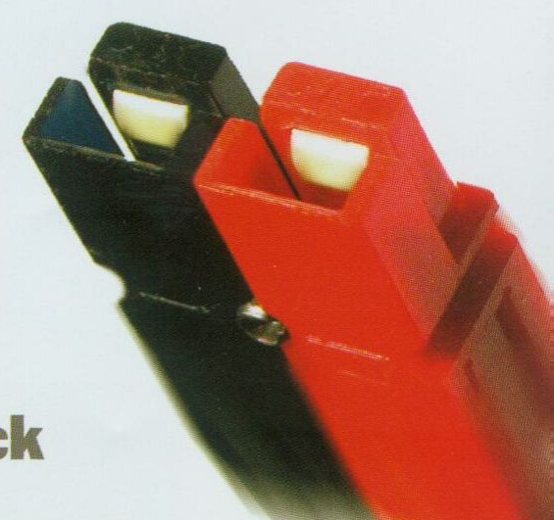
The RACES and ARES Standard
The 30A Anderson Powerpole has been adopted by the amateur radio community as their standard 12-volt DC power connector for everything from radios to accessories.
Standard polarity configuration is one red housing for positive and one black housing for negative.
Remember this Mnemonic:
  “Red on Right, Tongue on Top”

Slide 26
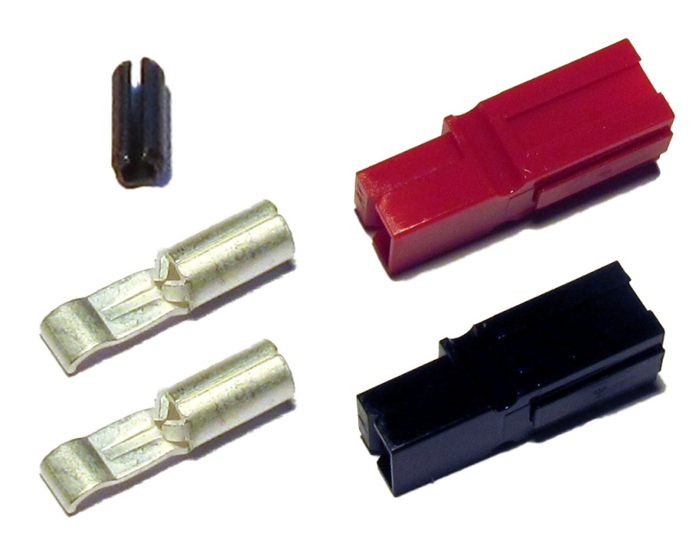
Anderson Powerpoles
One connector for 15A to 45A
Three contact options allow use of 10 to 20 gauge wire
Low voltage drop (< 0.02 volts)
Inexpensive (approx. $1 ea. retail)
Exceeds current rating of wire (based on max temp rise)

Slide 27
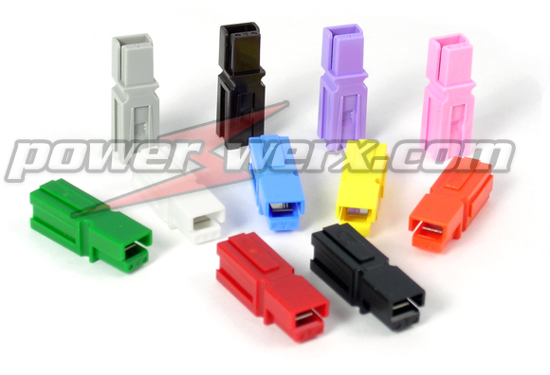
Anderson Powerpoles
Flat wiping contact system is self-cleaning
Can be disconnected while energized with little arc
No soldering required!
Keyed, interchangeable, and genderless
Physically and electrically hermaphroditic
Wide product range - From 10 amps through 180 amps
Polarized housings
Colored, modular housings
(11 different colors!)

Slide 28
Benefits
Allows for minimal contact resistance at high current, wiping action cleans contact surface during disconnection.
Simplifies assembly requirements and reduces parts inventory.
Allows customized multi-pole configurations with visual color coding to match wires.
Prevents damage to connectors from being mated incorrectly.
Allows versatility to choose product best suited to design requirements.
Provides security in knowledge that the connector chosen meets strict UL flammability ratings.

Slide 29
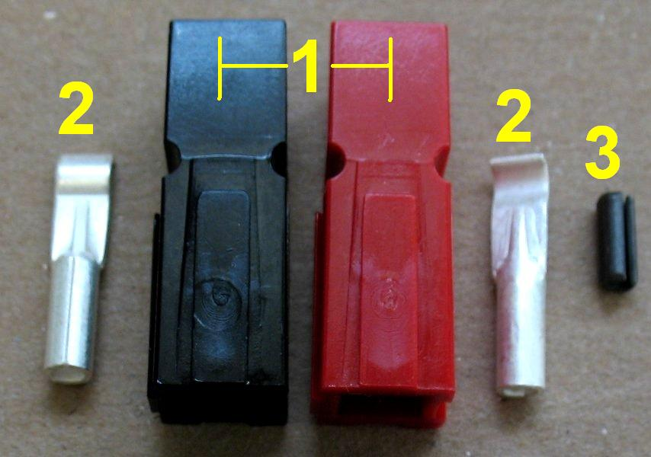
Powerpole Parts Breakdown
Housing
Contacts
Lock pin (or use glue instead)

Slide 30
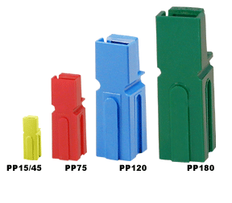
Powerpole Identification
4 different sizes of housings
PP15/30/45
PP75
PP120
PP180
Only PP15/30/45 are interchangeable. All others are not!

Slide 31
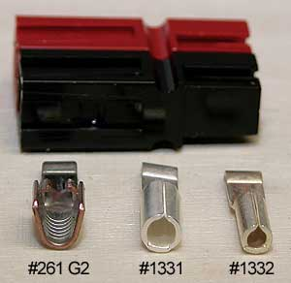
PP15/30/45 Differences
15/30- Only difference is the size of the wire barrel on contact
45-Style of wire mount is different than the 15/30
When connected, hard to distinguish other than wire gauge used.
45A 30A 15A

Slide 32
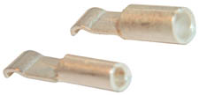
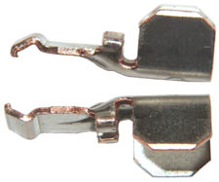
Contact Selection
15A / 30A / 45A What is the wire size?
15 20~16ga
30 16~12ga
45 14~10ga
All contacts are copper plated with tin or silver

Slide 33
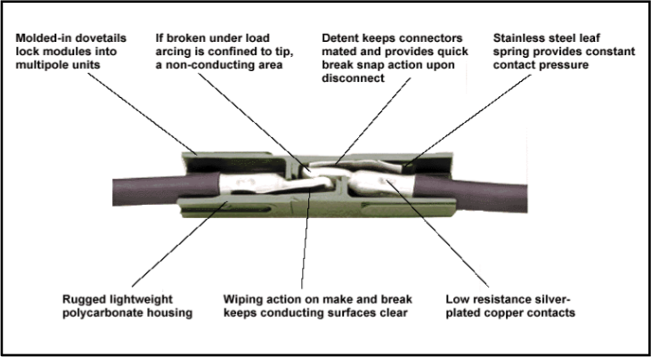
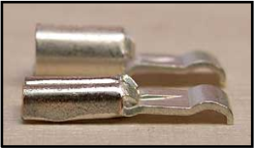
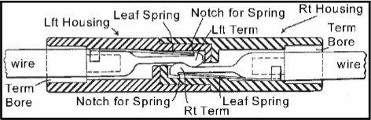
Powerpole Anatomy

Slide 34
Assembly Overview
Assemble the housings using the dovetails.
Square off the wire ends
If using zip wire, split pair about ½ inch.
Strip 5/16 inch of insulation from wire.
  Take care to avoid knicking or cutting wire strands.
Insert untinned wire into the contact barrel.
  If stranded, twist the bundle tight.
Crimp the contact.
Insert the contact into the connector housing until it clicks.

Slide 35
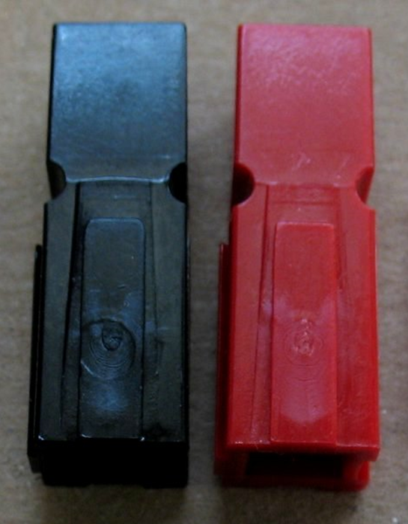
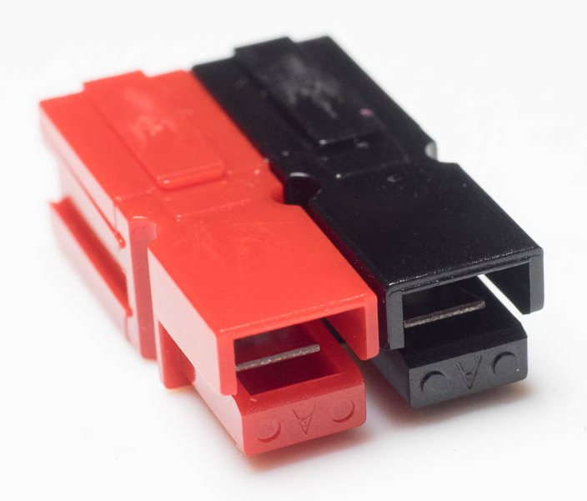
Housing Assembly
Get the correct orientation.
ONE DROP of glue (don’t need much) on the inside dovetail.
QUICKLY and with a little force, slide them together till they are both even.
Did you know there are now ultrasonically welded, permanently bonded housing sets?

Slide 36
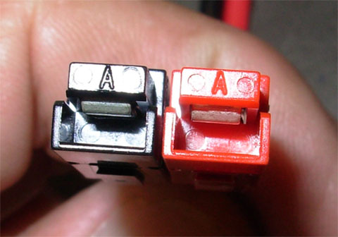
Assembly
Housing orientation VERY important.
As you are looking at the connector
  Tongues up
  “A”s up
  Black on left
  Red on right
“Red on Right, Tongue on Top”

Slide 37
Contact Crimper
Heart of the assembly procedure!
Mess this up and you’ve botched the whole thing
  Contact won’t go in
  Contact won’t lock in
  WIRE CAN COME OUT!
Three different styles
  Not Recommended
  Money to Burn
  Just Right!

Slide 38
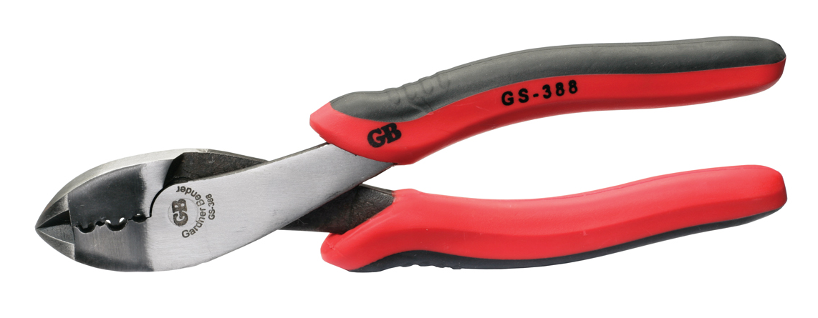
Universal Crimping Pliers
Guaranteed to mess up
Inconsistent results
Inexpensive…$15 or less

Slide 39
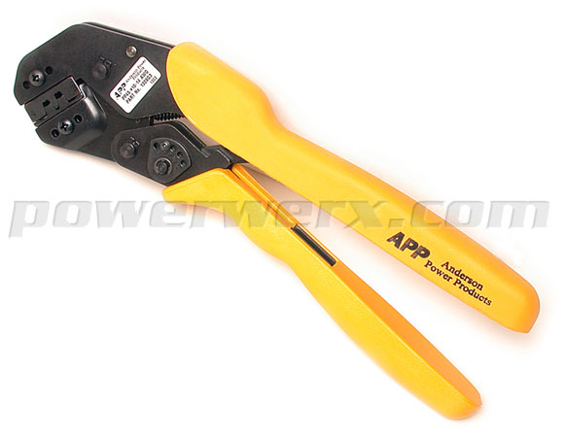
Top of the Line
Official Anderson Power Pole Crimper
Consistent results
Only does 30 and 45A contacts
$219.99!

Slide 40
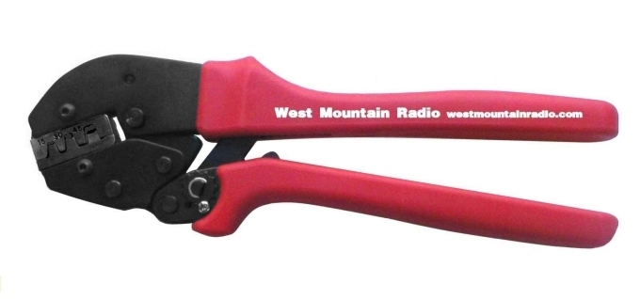
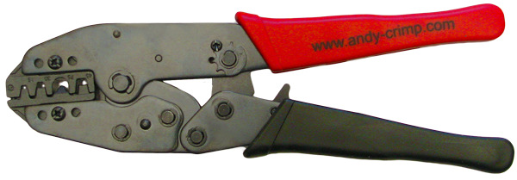
Just right!
15, 30, and 45A contacts!
Consistent results
Ratcheting mechanism
  Correct force applied each time
Interchangeable dies
West Mountain Radio crimper $39.95
Andy Crimp Pro (75A contacts also) $35.00

Slide 41
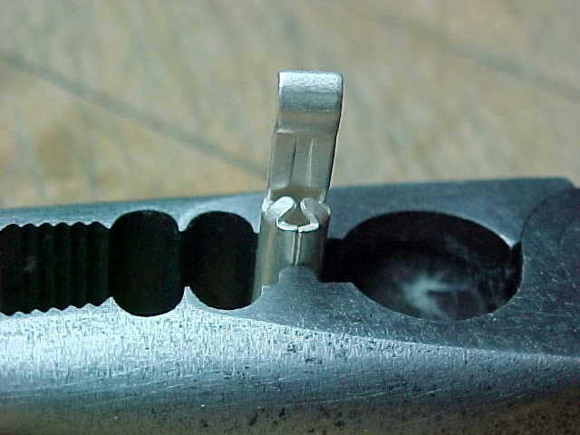
Crimping Procedure
Regardless of the crimping tool used, the seam in the barrel of the contact must be towards the open / flat side of the tool’s die.

Slide 42
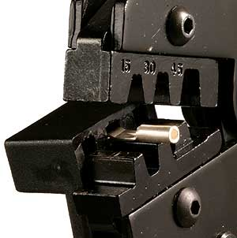
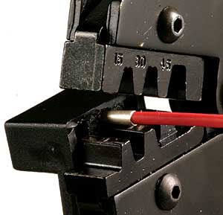
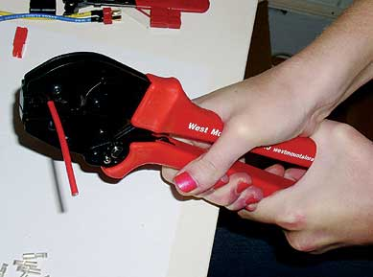
West Mountain Radio Crimper Procedure
Insert contact
Insert wire
Squeeze through each ratchet index, only until the tool opens

Slide 43

West Mountain Radio Crimper Procedure
Three crimping dies, marked 15, 30, and 45, for the respective contact ampere rating.
The contact holder extends off the other side of the lower jaw.
You should first try a dry run by squeezing the handles closed.
The ratchet will click at the end of each ratchet index, keep squeezing until the tool opens fully.

Slide 44

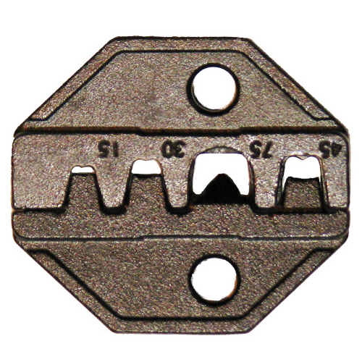
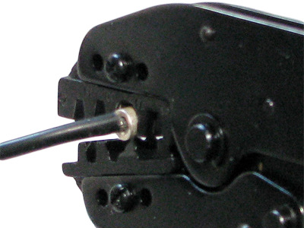
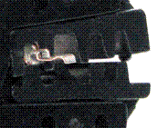
Andy Crimp Pro
Crimping Procedure
When holding the tool in your right hand
  The numbers appear “upside down”.
  The wire and the back end of the contact will be facing towards you.
  The seam of the 15 and 30 amp contact and the ‘U’ of the 45 amp contact will be facing up.
  The tongue / hook of the contact will be facing down on the other side of the die.

Slide 45
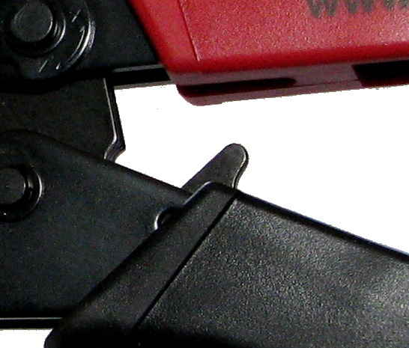
The Abort Lever
If for some reason you cannot completely crimp the contact
  Squeeze the handles slightly
  The release lever can be pushed towards the front of the tool
  This will allow the tool to be opened

Slide 46
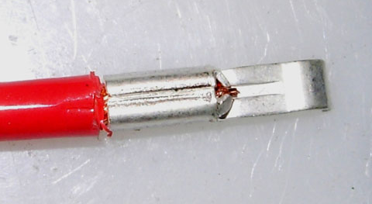
Should look like this!
1

Slide 47
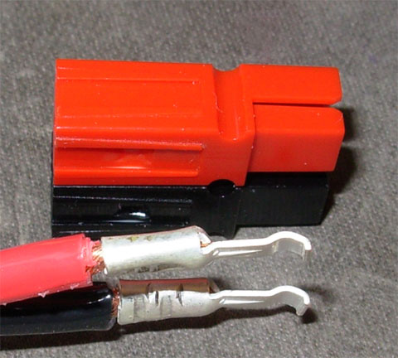
These are acceptable too!

Slide 48
These are acceptable too!
This is the correct orientation for insertion into a standard configuration housing

Slide 49
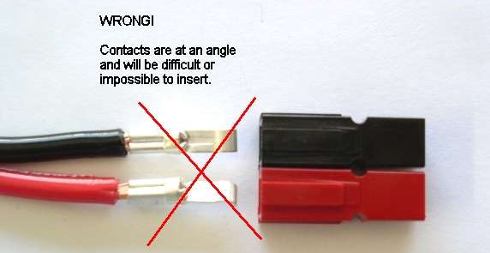
INCORRECT examples
Contacts at odd angle.
Twist them gently to correct orientation.
WRONG!
Contacts are at an angle and will be difficult or impossible to insert.

Slide 50
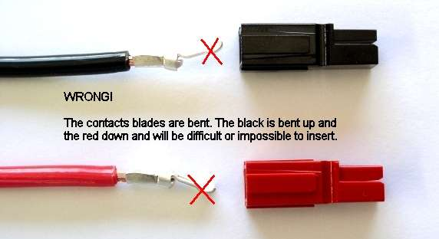
INCORRECT examples
Contact blades bent.
Gently straighten them up.
WRONG!
The contacts blades are bent. The black is bent up and the red down and will be difficult or impossible to insert.

Slide 51
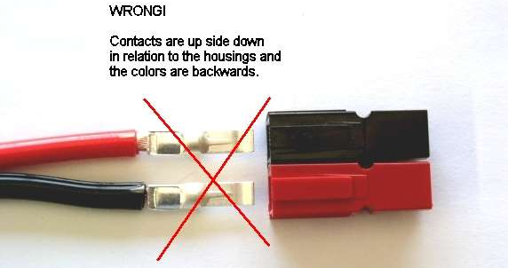
INCORRECT examples
WRONG ORIENTATION!
Flip wire and gently twist contact to match housings.
WRONG!
Contacts are up side down in relation to the housings and the colors are backwards.

Slide 52
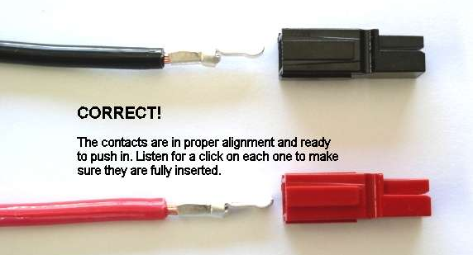
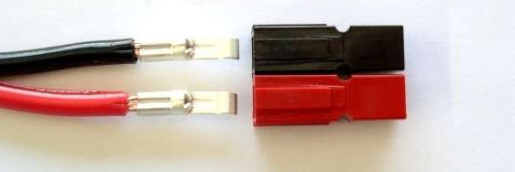
CORRECT examples
Contacts straight
Contacts correctly aligned
Contacts correctly polarized
Ready to insert
CORRECT!
Contacts are in proper alignment and ready to push in. Listen for a click on each one to make sure they are fully inserted.
CORRECT!
Contacts are in proper alignment and ready to push in. Listen for a

Slide 53
Final Connector Assembly
Insert contact “curve” towards the tongue (A).
Slide straight in until “CLICK” is heard or felt.
Tug back on wire to verify lock
Repeat with other contact.
DONE! One Powerpole completed!

Slide 54
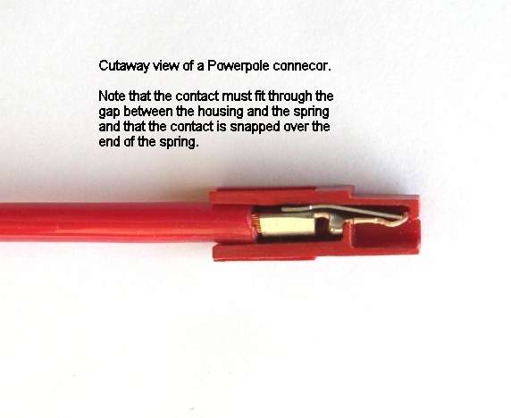
Cutaway showing contactor locked into connector
Cutaway view of Powerpole connector.
Note that the contact must fit through the gap between the housing and the spring, and that the contact is snapped over the end of the spring.

Slide 55
OOPS!
I goofed up, or I need to remove the wire/conductor.
What do I do?

Slide 56
Contact Removal
A special APP tool is available to help remove the contact from the shell.
BUT, a jewelers flat blade screwdriver or hobby knife is also probably available in your tool box that will do the same thing!
Procedure is to put the blade just under the contactor curve and lift up while pulling on the conductor. When the curve is clear, the conductor will pull right out.
(Kind of clunky first time you do it but it does work!)

Slide 57
Contact Removal
Lift this up!
Pull on this!
Cutaway view of Powerpole connector.
Note that the contact must fit through the gap between the housing and the spring, and that the contact is snapped over the end of the spring.

Slide 58
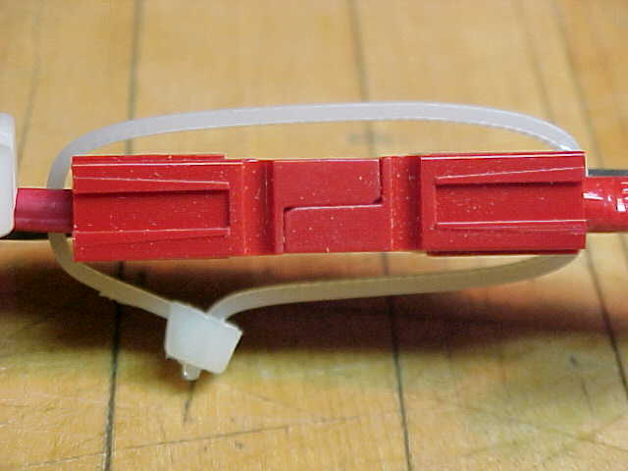
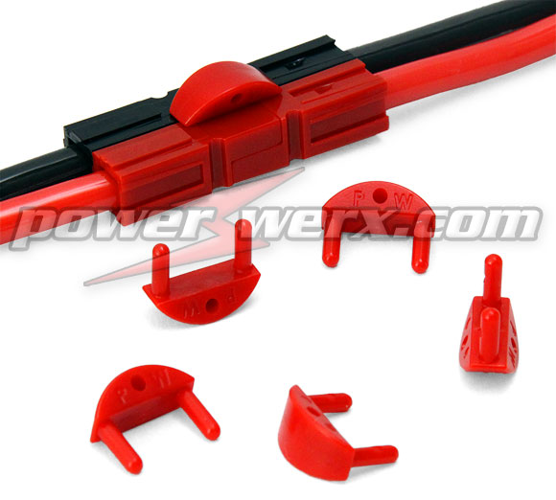

Retention Options

Slide 59



Powerpole Mounting Wing

Slide 60





Mounting Options

Slide 61

Moisture Proof Splash Boot

Slide 62

BLOK-LOK

Slide 63



More Options!

Slide 64
The 30A Powerpole is an ideal connector for 12v DC power connections.
Buy twice as many contacts as you will need for your project – crimping takes some skill.
Make lots of short jumper cables to other connector types (e.g. ring, spade, OEM T-type). They’re perfect for your emergency “jump-kit”.
Keep your housings, contacts, zip wire, and crimping tool in your jump kit. This way, you can make field repairs or even construct new cables on the spot.

Slide 65
FAQ’s
“The wire fits better in the 30A or the 45A connector but the widget is only drawing 10 amps. Can I use the higher capacity contact?”
You sure can! Nothing says you can’t use a higher amp contact. Just don’t go lower!
“I’m using 15A contacts and the wire is just too small. What do I do?”
Easy, double it then crimp it!

Slide 66

FAQ’s
“I’m not going to double the wire. That’s just now how I roll. Any other options?”
There sure is…
Reducing bushings!

Slide 67

FAQ’s
“I don’t crimp anything. Rosin runs in my blood and I keep a strand of 60/40 in my pocket at all times! Can I solder these puppies?”
Yes you can, but don’t use a huge iron to solder the thing and don’t flow too much up the wire to harden it. Less is more and don’t melt the insulation! Whatever you do, KEEP THE SOLDER OFF THE CONTACT SURFACE!!!

Slide 68



FAQ’s
“I’m a non-standard type-o-guy and none of my installations are standard…can these things make a non-standard configuration?”
Yes they can! Use your imagination and document your work!

Slide 69


Special Spacers Make Custom Keys

Slide 70

Powerpoles in Action

Slide 71

Powerpoles in Action

Slide 72

Powerpoles in Action

Slide 73

Powerpoles in Action

Slide 74

Powerpoles in Action

Slide 75
More Information
ARES/RACES Standard:
  www.races.net/sca/powrpole.html
Vendors include:
  www.powerwerx.com
  www.westmountainradio.com/
  www.dcpwr.com
  www.cablexperts.com (under DC Power)

Slide 76
Volts:
Move ‘Em Without Losing ‘Em
QUESTIONS?
Clint Miller KCØJUO
Story County EC
January 7th, 2015

