Slide 1
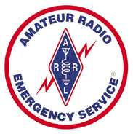
Data Modes for Emergency Communications
Clint Miller KCØJUO, COML
Story County ARES
October 5th, 2017

Slide 2
Digital vs. Data
Digital modes could mean voice or data
There are non-digital data modes
Using “data modes” clears up any confusion

Slide 3
Communication Modes
Communication modes fall into several categories:
Point to point -- Telephone, fax, radio voice and data
Multi-point – Radio voice, CW, and data modes
High precision -- Fax, e-mail, radio data modes
Low precision -- Radio voice and CW, telephone
High priority -- Radio voice, telephone
Low priority -- Fax, e-mail, radio data modes and CW

Slide 4
Message Categories
Message types fall into similar categories:
Point to point -- Messages intended for one party
Point to multi-point -- Messages intended for a group
Multi-point to point -- Messages from members of a group directed to one station
High precision -- Lists of items, medical or technical terminology, specialized or detailed information
Low precision -- Traffic reports, damage estimates, simple situation reports
High priority -- Fast delivery is critical
Low priority -- Messages can be delivered in a more relaxed time frame

Slide 5
Voice vs. Data
Voice modes are ideal for low-precision messages
Tactical
Time-critical
Could be formal written traffic
Data modes facilitate high-precision message transfer
Roster of evacuees
Prescription medication request
Directions through a disaster scene
Situation report
Lists and detailed messages

Slide 6
Why Data EmComm?
The needs of our Served Agencies have changed
They still need voice communications but...
There's an increasing need for data communications
We need to be able to provide more than just voice communications with an HT
Remember data modes are not secure
Most appropriate method might be hand delivery by a radio-dispatched courier

Slide 7
Why Data EmComm?
Some data modes provide virtually error-free transmission
Relays can be accomplished by retransmitting the received data message without having to retype
Documentation and printing of message text
Record of when message was sent / received

Slide 8
Historic Progression of Data Modes for EmComm
CW (and high-speed CW)
RTTY (Radio TeleTYpe)
AMTOR (error-correction for amateur RTTY)
Packet (AX.25 protocol – requires TNC)
PACTOR (hardware modem)
APRS (Automatic Packet Reporting System)
Sound Card Modes (including PSK, FSK, MFSK, etc…)
Sound card software allows rapid mode experimentation and development

Slide 9
Historic Progression of Data Modes for Emergency Communications
The trend has been to modes with:
Higher bitrates
Better copy with lower signal to noise (robust)
Automatic error correction techniques

Slide 10
Requirements for
HF Data Modes
Noise and interference tolerant
Good weak signal performance
Error correction techniques
FEC, ARQ, interleaving, et al
In a word… ROBUST!

Slide 11
What HF Modes
Are Available?
“QSO” modes – not well-suited to EmComm
BPSK31, RTTY, others
More robust modes
MFSK16, MT63, Olivia, PACTOR, and more
“Interesting” modes
JT9, JT65, MSK144, FT8

Slide 12
Winlink
Not a mode…
Method of interconnected messaging
Worldwide “hybrid” email network
Utilizes multiple different data modes
WINMOR
PACTOR
D-Star
AX.25 packet (300 baud limit on HF)
802.11 (Wi-Fi)
TCP/IP (including telnet)

Slide 13
Winlink
Numerous Radio Mail Server (RMS) stations maintained on a volunteer basis by licensed amateurs
Each RMS station is connected through the Internet (Telnet) to Winlink system
Network of 5 redundant Common Message Servers
"CMS"
RMS Express recommended interface
Provides a complete email messaging system

Slide 14
Winlink on VHF/UHF
VHF/UHF packet radio gateways to the system
Automated messaging using 1200 baud AX.25 packet
Now integrated into RMS Express software
Soundcard access using UZ7HO SoundModem
Not using AGWPE any more
Ideal to provide a temporary portable or fixed emergency portal for radio e-mail users
Can do one-to-one connections

Slide 15
Images and Video
Amateur TV
Slow-scan for photos
Fast-scan for video
High Speed Multimedia
Voice over Internet protocol (VoIP)
Cameras
Instant messaging
Video conferencing
Remote station control
Repeater linking
Send real-time video and data files

Slide 16
High Speed Multimedia
802.11
Mesh Networking
Broadband-Hamnet
AREDN
Amateur Radio Emergency Data Network
Uses new, off-the-shelf equipment
2 channels on 2.4 GHz
24 channels on 3.4 GHz
7 channels on 5.8 GHz
Can use public channels but they are crowded!

Slide 17
Automatic Link Establishment (ALE)
Method for digitally initiating and sustaining HF radio communications
Avoids guesswork, beacon listening, and complicated HF prediction charts
Each HF SSB transceiver constantly scans through list of frequencies, listening for its callsign / address
On schedule, transceiver transmits its station ID
Local system records best paths between stations
Operator enters callsign, system chooses best path, and software connects the stations
http://hflink.com

Slide 18
Why should we focus on VHF/UHF?
Most probable communications emergency scenario will be exclusively local
“Last Mile” communications are our most likely role
HF ground wave or NVIS could be an option
VHF/UHF simplex or repeaters will usually be able to address “Last Mile” needs
Nearly every ham owns a VHF/UHF radio
Technicians aren’t excluded

Slide 19
VHF/UHF Modes
Most popular ones are...
MT63 (500, 1000, 2000 long)‏
Olivia
Domino
“R” PSK modes...fast with FEC
PSK31
Good for making non-emcomm contacts
No error correction

Slide 20
High-Speed Modes
Fast modes now available:
PSK-125R
PSK-250R
PSK-500R
“R” signifies Robust
Contains Forward Error Correction (FEC)
PSK-500R is approximately twice as fast as MT63-2000

Slide 21
High-Speed
Multi-Carrier Modes
Multi-psk modes now available
PSK signals sent in parallel, up to 12 carriers
Can have parallel PSK and PSKR modes
Blazingly fast
Must trade off speed vs robustness
Good compromise mode...PSK125R x 5
Modes of multi 500 Hz wide carriers not legal on HF

Slide 22
ARES Software Standards?
There are NO national or Iowa messaging and software standards
Local ARES groups can decide which modes, bands, or software fits their needs
Some groups have chosen:
Winlink
NBEMS
Packet
Most groups have
no official system
don’t offer data messaging

Slide 23
Equipment for
Data Messaging
Radio to receive and transmit
Just about any radio will due for testing and practice
Watch duty cycles and battery life
Data jacks to allow easier interfacing
Interface from radio to computer
SignaLink USB
Rigblaster
Homebrew interface
Keying circuit or VOX
Acoustical coupling

Slide 24
Equipment for
Data Messaging
Computer to decode and display messages
PC or laptop
Linux or Android single board computer
Tablet or phone
Software to compose and decode messages
Printer
Scanner

Slide 25
Software Options
APRS
ATV
Packet
Winlink
NBEMS (Fldigi)

Slide 26
Narrow Band Emergency Messaging System
Consists of multiple programs:
Fldigi – Fast Light Digital modem application
Flwrap – embed a checksum in a file
Flmsg – easily send ICS forms and Radiograms
Flarq – automatic repeat requests (ARQ)
Can download from www.w1hkj.com
Runs on Windows (XP or newer), Linux, Mac
Android using AndFlmsg app
Open Source, released under GNU Public License, it is completely FREE

Slide 27
Western Pennsylvania ARES
Using NBEMS extensively
Published standards online
Great template to design our own local standards for data messaging
Included standards
Modes
File verification
Transmission of binary files
Formal VHF/UHF and HF net procedures
wpaares.org/html/nbems.html

Slide 29
Western Pennsylvania ARES
Standard Modes
VHF/UHF FM
MT63-2000 long
HF Keyboard Chat
Olivia 8/500 - good conditions
Olivia 16/500 - bad conditions
HF Bulletins
MT63-1000 - good conditions
MT63-500 - bad conditions

Slide 30
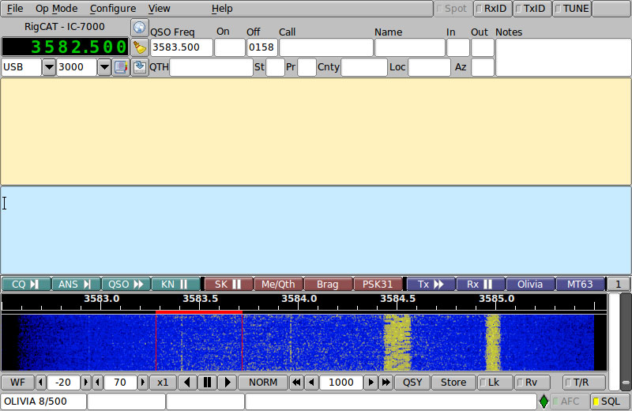
Fldigi

Slide 31
How it works
Fldigi uses your computer's sound card to generate and decode data signals
SignaLink adds separate sound card and VOX
All work is done by your computer, no external Terminal Node Controller (TNC)
Audio from your computer speakers go into your radio's mic input for transmission
Audio from your radio goes into your computer's mic or line-in for decoding
Don't need an extremely powerful new computer, older machines work just fine

Slide 32
Convert from Contest Mode to Message Mode
Load messaging specific macros
Turn on RSID transmit and receive
Configure>IDs
Check Searches passband
Add a Pre-Signal Tone of 1 or 2 seconds
Start New Modem at Sweet Spot unchecked
Configure->Defaults->Misc
Configure>Save Config
Set up multiple Fldigi configurations!

Slide 33
Flmsg – Send/Receive Messages
Flmsg used to send formatted messages:
ICS forms like ICS-213
ARRL Radiograms
Blank text
Easy workflow for CSV spreadsheets
Starts transmission automatically
Eases importing and checksum verification of incoming message
Can have incoming messages automatically opened

Slide 34
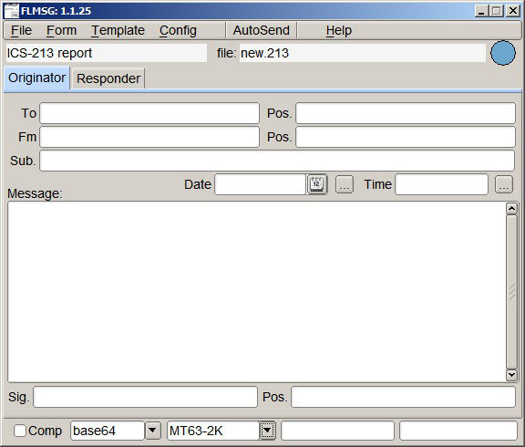
Flmsg Screenshot

Slide 35
Data Verification with Checksums
Checksums allow you to be 100% sure your message was received accurately
Checksum is inserted into a file by Flmsg
Receiving station computes the checksum on the incoming file and...
If the two checksums are identical, the file was received without error
Allows multiple stations to receive and confirm data 100%
Great for bulletins like situation updates, weather reports, road closures, lists of contact info

Slide 36
Example
This is an example of a file with a checksum:
[WRAP:beg][WRAP:crlf][WRAP:fn example.txt]This is an example of a wrapped file.
Here's what happens when we wrap something.[WRAP:chksum B71E][WRAP:end]
Note the WRAP beg and end delimiters
Also note the checksum, it's B71E
Flmsg automatically generates checksums
Flmsg also computes checksums on incoming messages

Slide 37
Flmsg – AutoSend Workflow
One click sending
Enter text directly into large empty box
Can also drag-and-drop text file into box
Push the AutoSend menu at top
Will be prompted to save file with automatically assigned unique filename
Flmsg will cause Fldigi to automatically send message

Slide 38
Flmsg Auto Display of Messages
Incoming messages can be automatically opened in Flmsg
Can also auto open messages in browsers
Can walk away and come back to see messages displayed
Display in browser great for EOC or served agency facility
Email or print for delivery

Slide 39
Flmsg – Send ICS-213 and ARRL Radiogram
Flmsg is a powerful tool in NBEMS
Can send ICS, ARRL Radiogram, Red Cross and Hospital forms
ICS forms include (not complete list):
ICS-203 Organization Assignment List
ICS-205 Incident Radio Communications Plan
ICS-213 General Message (most common)
ICS-214 Unit Log
Can send and receive files very easily with 100% verification

Slide 40
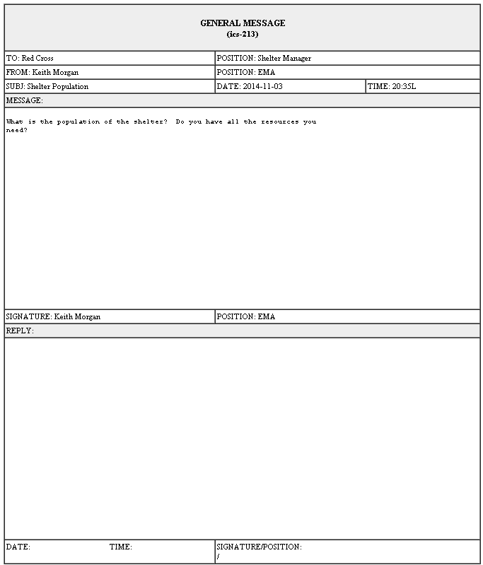
ICS-213 in HTML

Slide 41
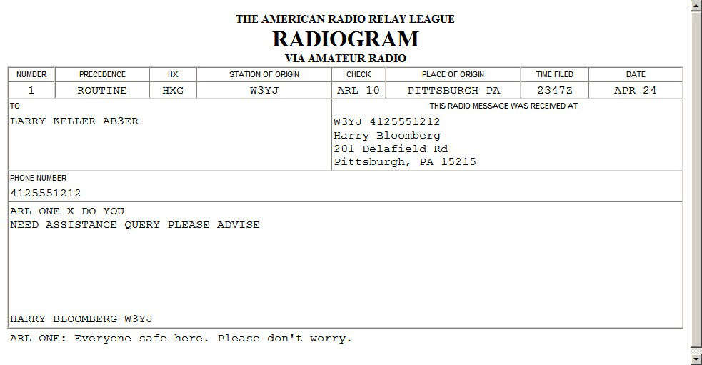
Flmsg – Radiogram HTML Format

Slide 42
Flmsg Custom Templates
Say you need a standard report for...
Hospital bed count
Shelter info
Resource request
Situation report (sitrep)
Flmsg supports custom templates
Distribute before event, or even over the air
Import template into Flmsg, fill it out and transmit
Windows: User > NBEMS files > CUSTOM
Use Template menu to save and load

Slide 43
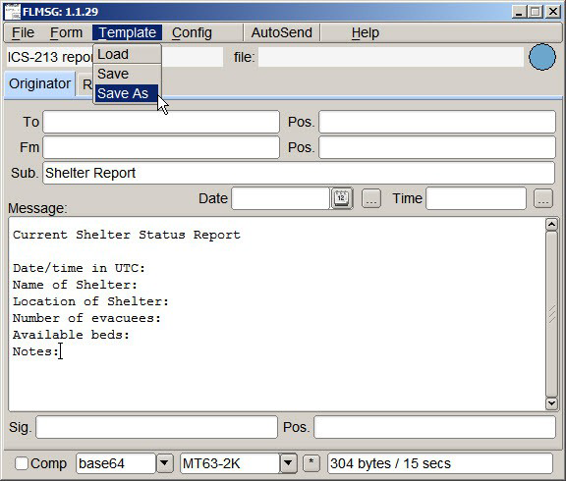
Flmsg Templates

Slide 44
Story EMA Sitrep Template
Started with standard Situation Report format from Story County EMA
KCØEDE converted to an HTML document
Without formatting, text file is much smaller
Smaller means faster
Distribute before event or disaster
Possible to send over air if necessary
http://storyares.org/downloads
Story County EMA SITREP for NBEMS – DRAFT

Slide 46
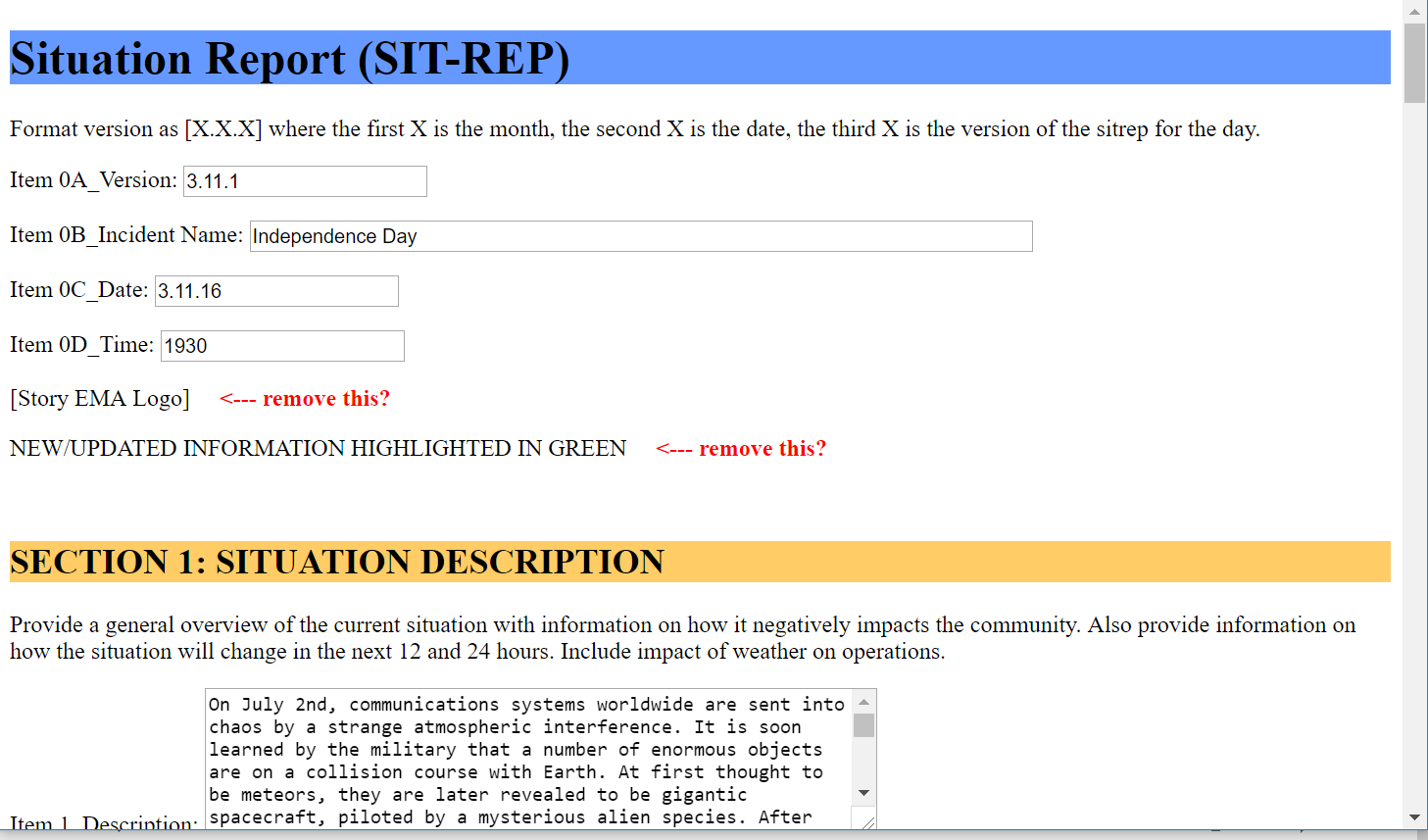

Slide 47
Data Guidelines for NBEMS
Send only text files, no binary files
Do not send Word Documents, save as text
Excel spreadsheets must be exported as CSV
Do not send images
Limit file size to avoid repeater timeouts
CRITICAL: Meet with Served Agency beforehand to set expectations
Encourage Served Agency to give us data electronically
Remember, we have limited bandwidth

Slide 48
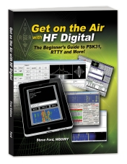
Resources
Story County ARES
http://storyares.org/
High Speed Multimedia for Amateur Radio
Get on the Air with HF Digital

Slide 49
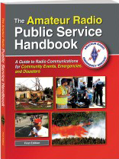
Resources
ARRL's Public Service Handbook
NBEMSham Yahoo group
Western PA ARES NBEMS Website: http://wpaares.org/html/nbems.html
User Guides and examples

Slide 50
Resources
W1HJK (author of Fldigi) http://www.w1hkj.com/
QST Articles
April 2008
August 2009
September 2013
ARRL NBEMS page http://www.arrl.org/nbems

Slide 51
ARRL Technical Descriptions
FCC rules § 97.309(a)(4) calls for technical characteristics
(4) An amateur station transmitting a RTTY or data emission using a digital code specified in this paragraph may use any technique whose technical characteristics have been documented publicly, such as CLOVER, G-TOR, or PacTOR, for the purpose of facilitating communications.
http://www.arrl.org/technical-characteristics

Slide 52
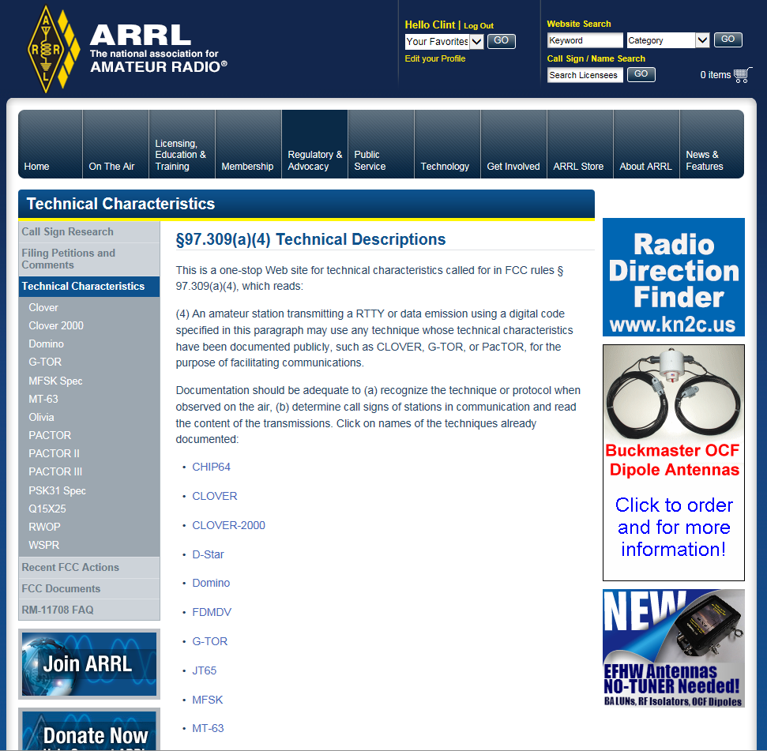

Slide 53
IA ARES Digital Net
Tuesdays 7:00 pm
3.5725 MHz +/- USB
Olivia 8/500

Slide 54
Final Thoughts
Learn HF modes (especially Winlink) if you have national deployment aspirations
Building our response capabilities around NBEMS on VHF/UHF
We plan to develop and publish standards
Use WPA ARES standards for now
Until standards are defined, experiment until you find what works
Upcoming NBEMS Workshop
Establish data net on local repeater
Data modes with no automatic error correction should only be used when clean and interference-free signals can be guaranteed

